Slide 1
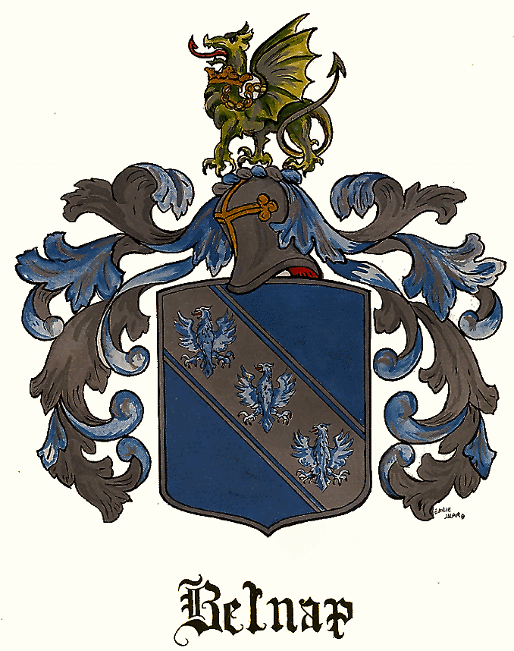
From Sawbridgeworth to Shoreditch: the Changing Fortunes of the English Belnaps
39th Belnap Family Reunion, 14th August 2010 Eden, Utah
By Graham Dixon & Nicholas Dixon

Slide 2
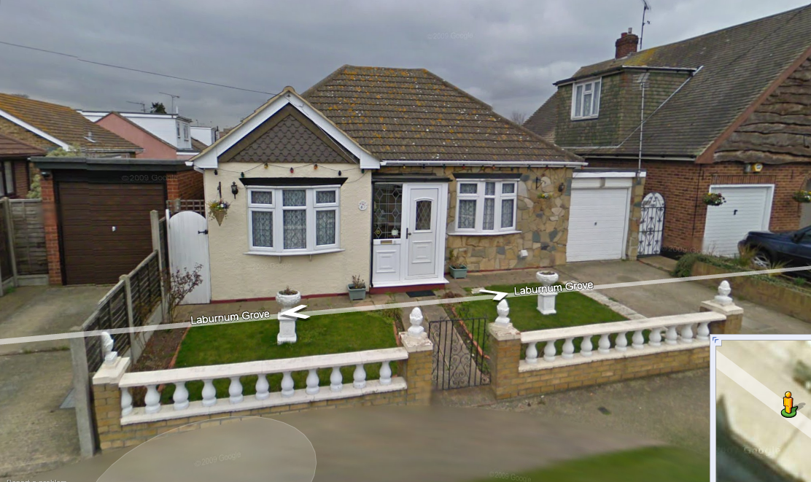

Slide 3
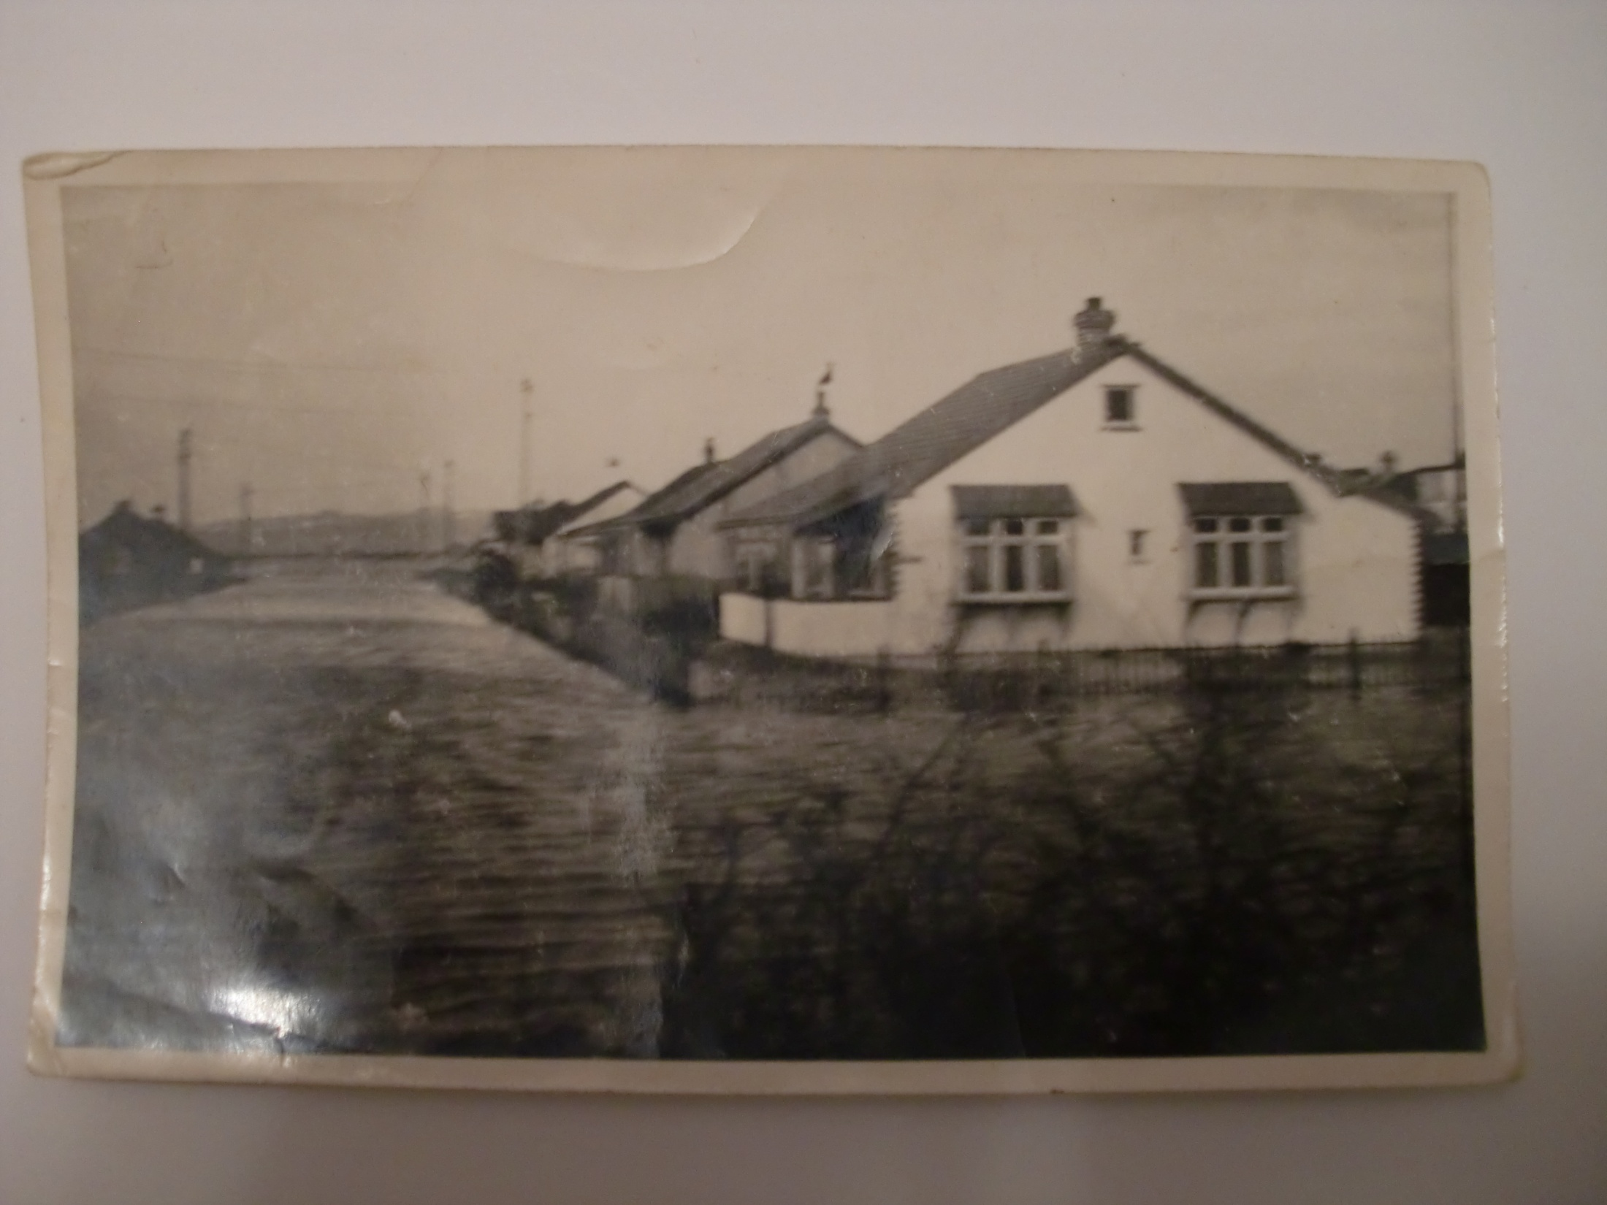

Slide 4
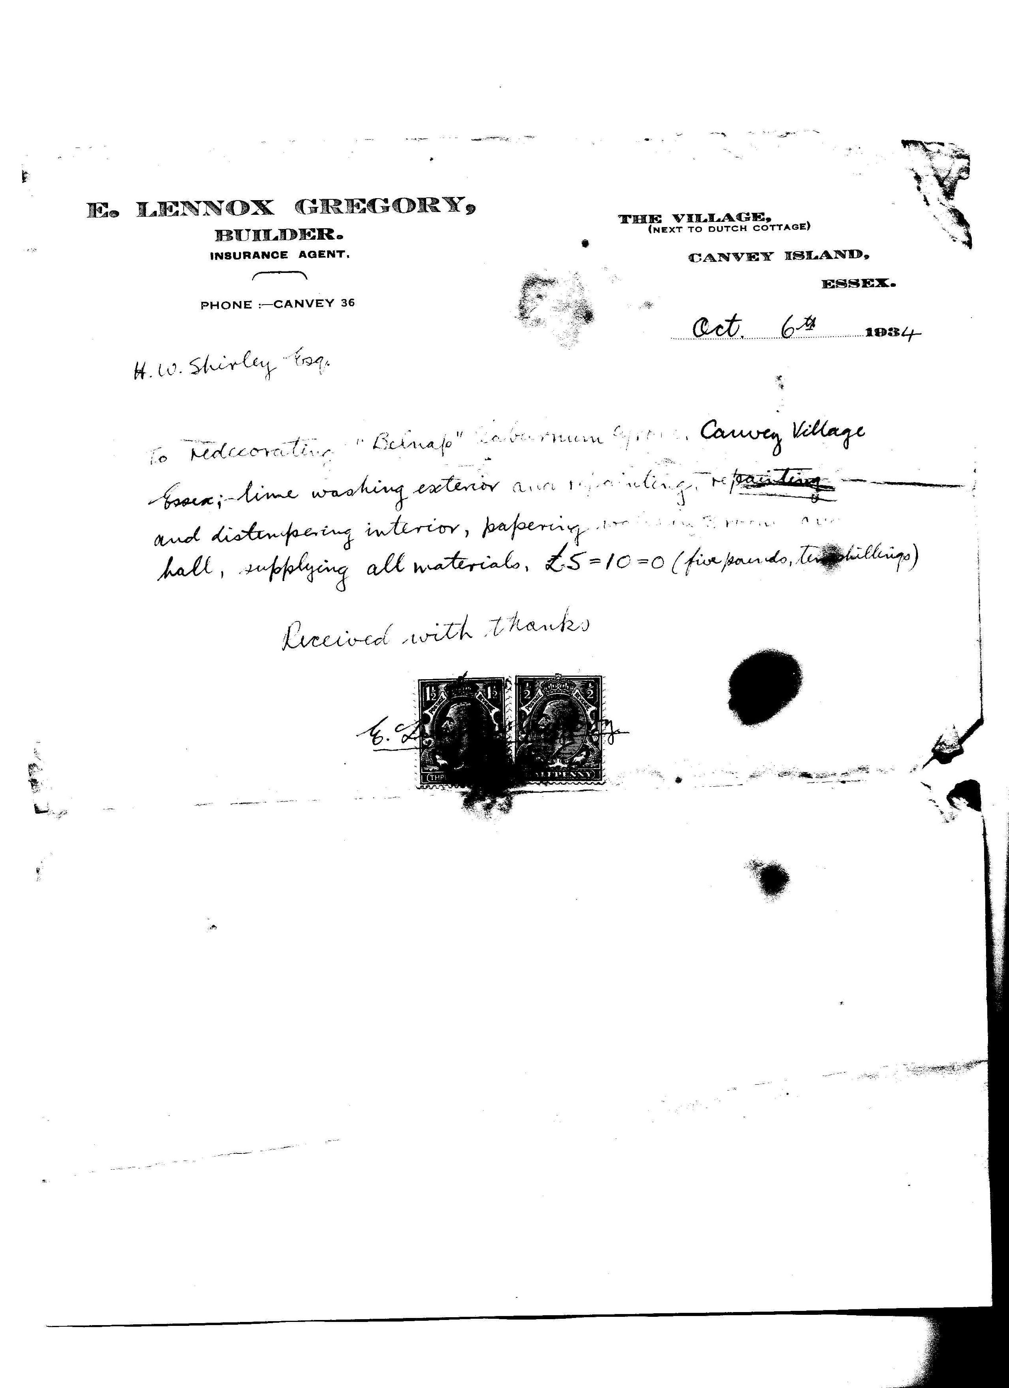

Slide 5
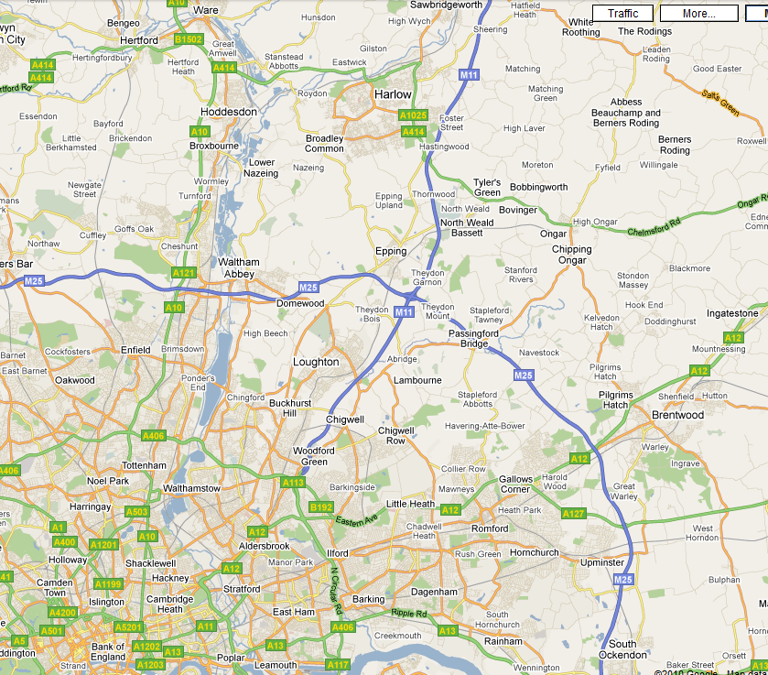
HACKNEY
SHOREDITCH
SAWBRIDGEWORTH

Slide 6
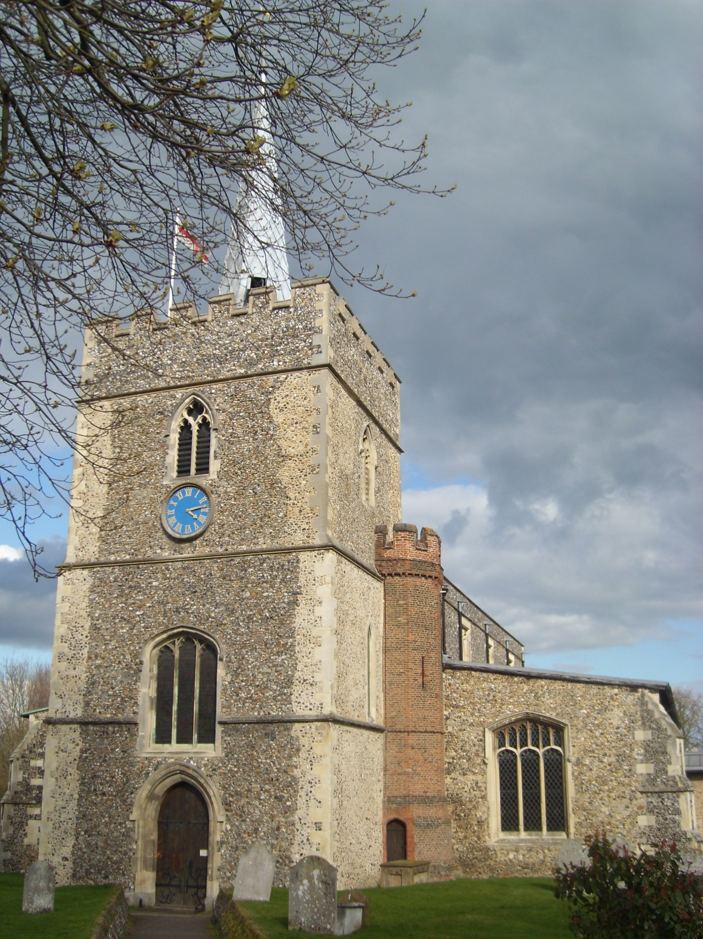

Slide 7
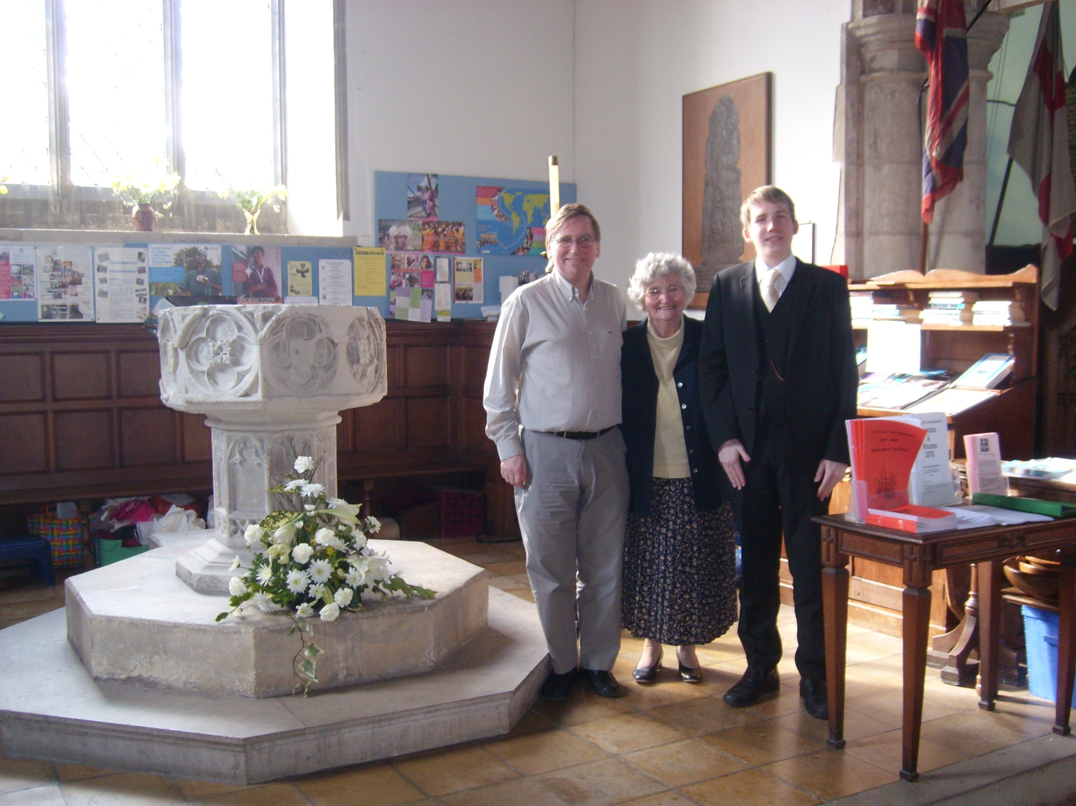

Slide 8
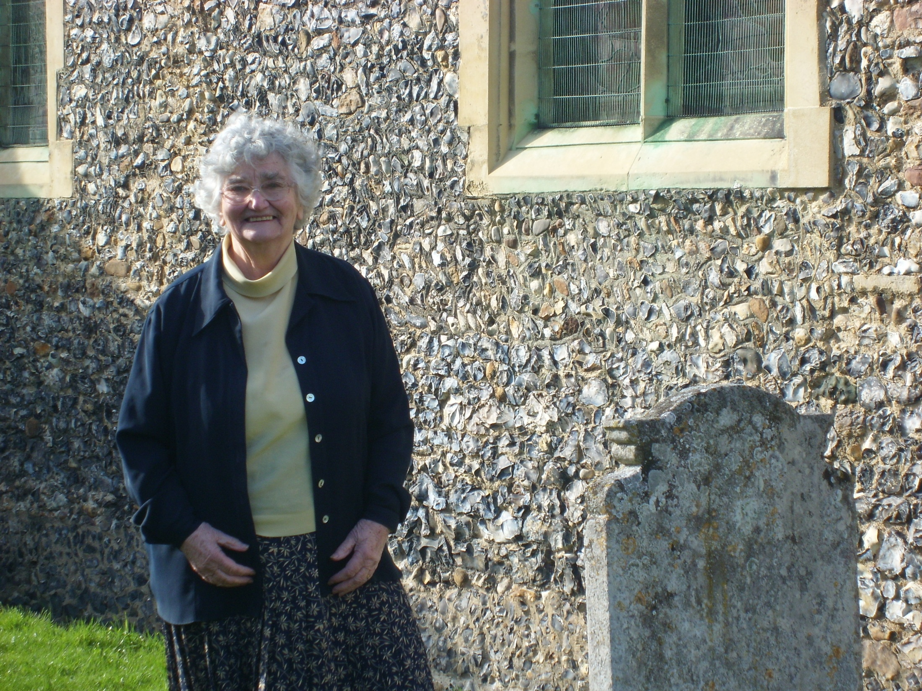

Slide 9
Children of Bennet Belknap (1559)
Abraham (1589/90)
Frances (1590/91)
John (1593)
Daniel (1595)
Josias (1599)
To America
Marries Edward Doucet
Marries Elizabeth: Grace, John, Elizabeth
Marries Barbara: Daniel (1634), Henry, Samuel, Barbara (b. Netteswell)
Marries Anne: Josias, Mary, Daniel (1635), John, James, Grace

Slide 10
Bennett 1559
Daniel 1595-1658
Josias 1599
Daniel 1634
Henry 1637
Daniel 1635
James 1640
Daniel 1668/9
Daniel 1675

Slide 11
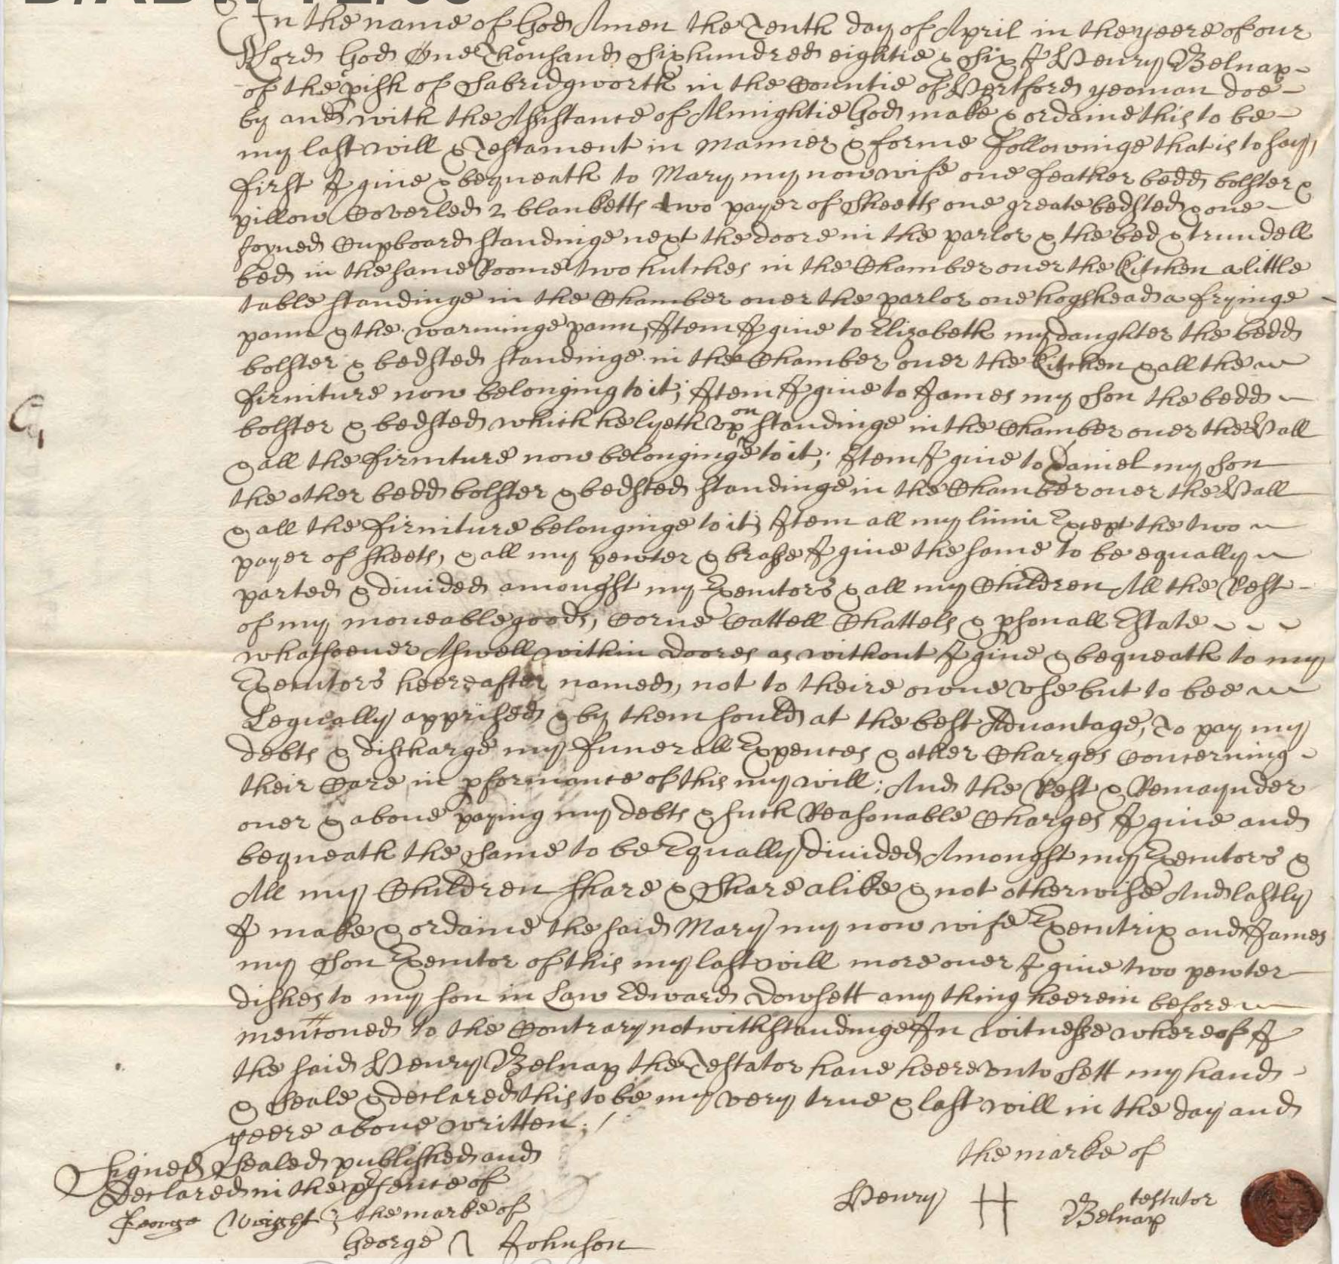
Notes:
The will of Henry Belnap of Sawbridgeworth, 1686

Slide 12
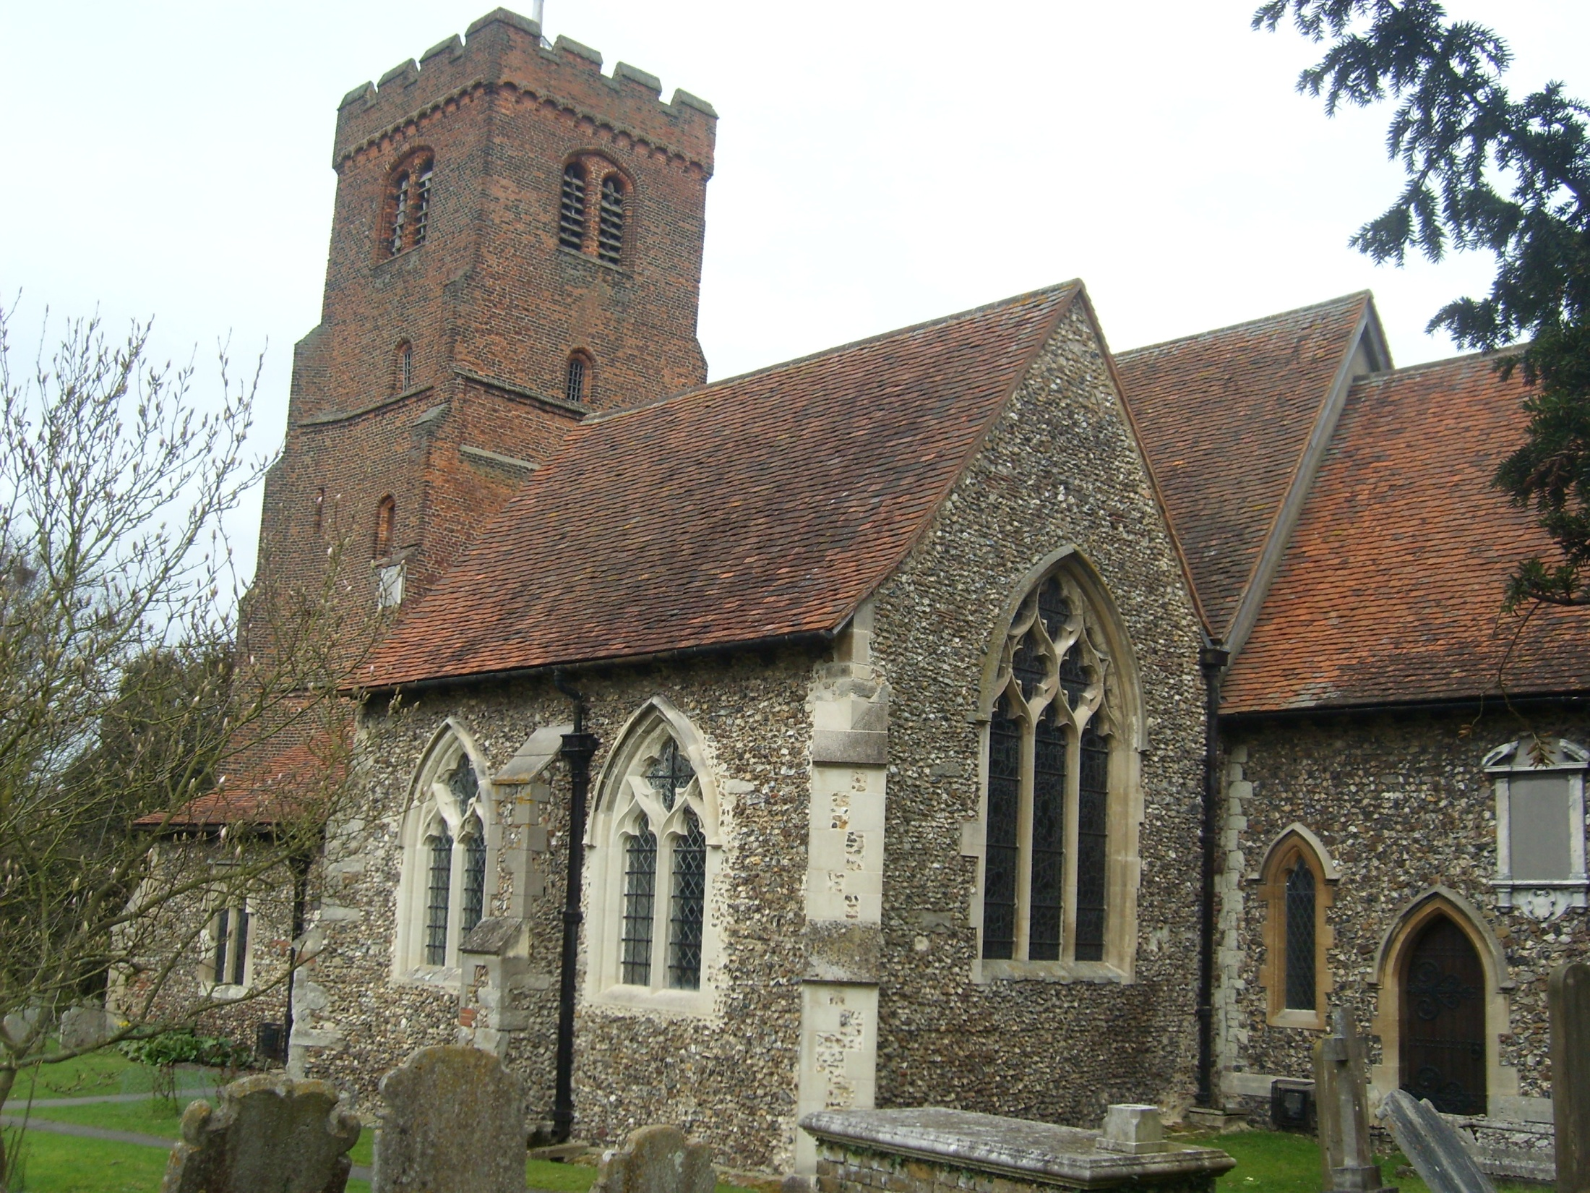

Slide 13
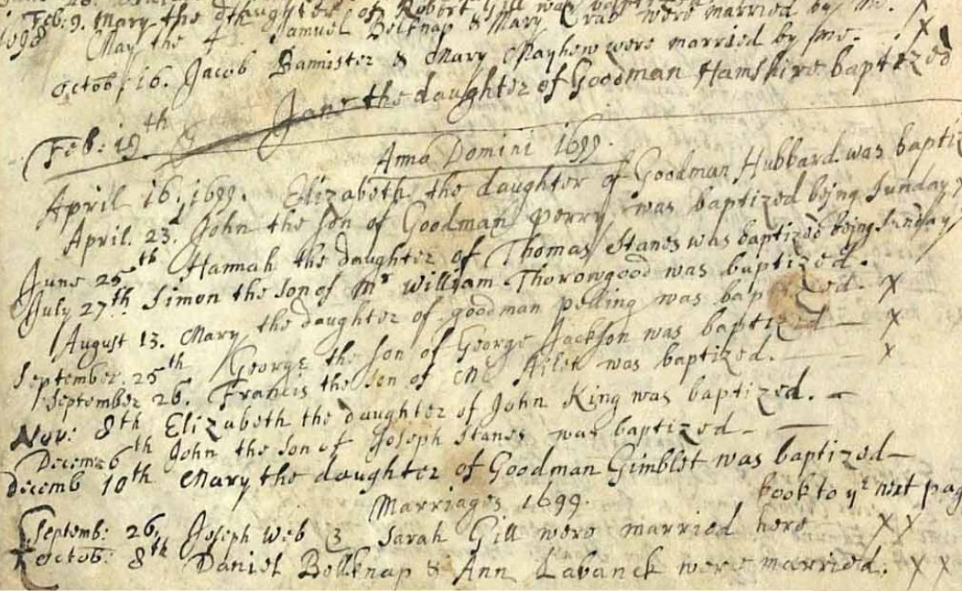

Slide 14
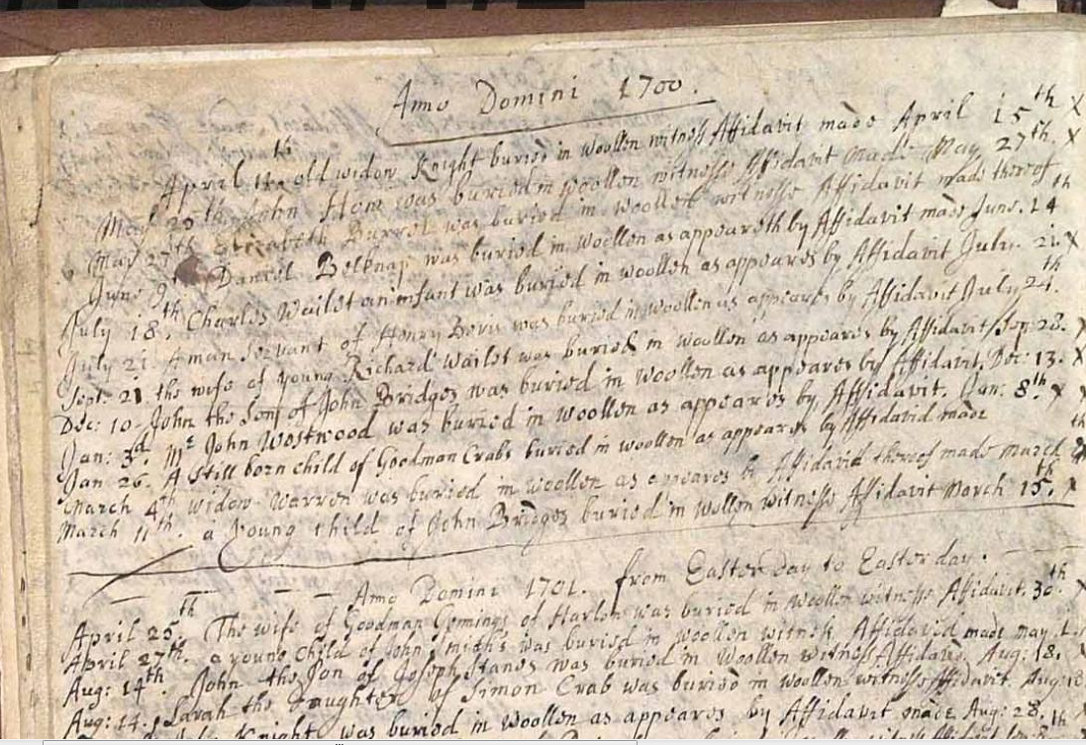

Slide 16
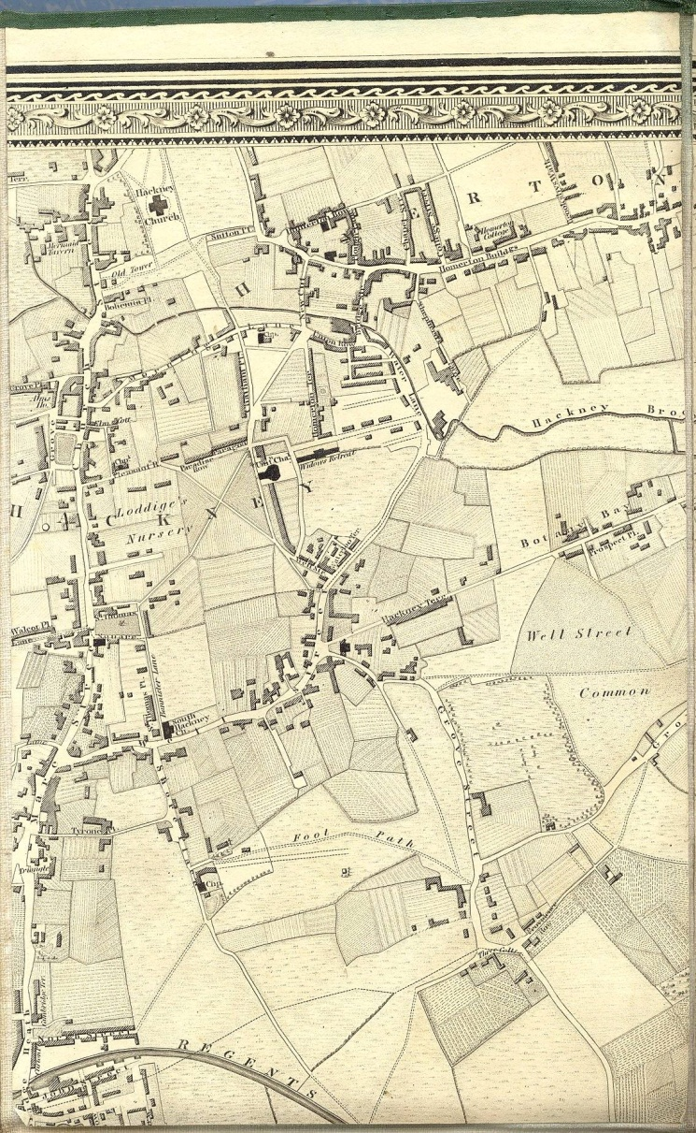
Daniel Belknap
Baptised at North Weald Bassett on 30th June 1700.
Married Elizabeth Bolton on 3rd October 1733 at St. John’s, Hackney.
Nine children, two died.
Worked as butcher.
Notes:
Baptised at North Weald Bassett on 30th June 1700, and came to London
Married Elizabeth Bolton on 3rd October 1733 at St. John’s, Hackney. They had nine children, including two infant mortalities. These are recorded in the Hackney parish records:
13th October 1735. Elizabeth Bleven made oath that William Knight Alice Reeve Ann Bellknapp & Martha Atken late of the Parish of Hackney Deceased were buryed in Sheeps Wool only.
29th March 1738. Burials in woollen: J Whaeley A Belknap J Jewell
A butcher by a trade. The petty sessions book records this misdemeanour on 12th December 1752:
Daniel Bellnapp of Homerton Butcher. Confessed That a Peice of a Breast of Mutton was Sold by his Servant [draft minutes add: to John Price] (but said it was without his knowledge) declared he hath not, and promised he will not, sell Meat on Sundays Therefore was, for this time, Excused.

Slide 17
Daniel Belknap
Petty sessions book, December 1752:
Daniel Bellnapp of Homerton Butcher. Confessed That a Peice of a Breast of Mutton was Sold by his Servant (but said it was without his knowledge) declared he hath not, and promised he will not, sell Meat on Sundays Therefore was, for this time, Excused.
Notes:
Baptised at North Weald Bassett on 30th June 1700, and came to London
Married Elizabeth Bolton on 3rd October 1733 at St. John’s, Hackney. They had nine children, including two infant mortalities. These are recorded in the Hackney parish records:
13th October 1735. Elizabeth Bleven made oath that William Knight Alice Reeve Ann Bellknapp & Martha Atken late of the Parish of Hackney Deceased were buryed in Sheeps Wool only.
29th March 1738. Burials in woollen: J Whaeley A Belknap J Jewell
A butcher by a trade. The petty sessions book records this misdemeanour on 12th December 1752:
Daniel Bellnapp of Homerton Butcher. Confessed That a Peice of a Breast of Mutton was Sold by his Servant [draft minutes add: to John Price] (but said it was without his knowledge) declared he hath not, and promised he will not, sell Meat on Sundays Therefore was, for this time, Excused.

Slide 18
Daniel Belknap
Daniel Belknap’s wife Elizabeth died in 1750.
Married Ann Apsley, St. Giles, Cripplegate on 8th October 1752.
Two sons : Daniel (1753) and John (1755) – both baptised Hackney.
John Darnell and Daniel Bellnap appeared and paid the Sum of Four Pounds One Shilling and Seven pence halfpenny being the Ballance of their Accompts already given in & allowed for the year 1748 to John Woodfeild their Successor in the said Office.
St. John’s, Hackney, c. 1750
Notes:
Daniel Belknap’s wife Elizabeth died in 1750. His second wife was Ann Apsley, whom he married at St. Giles Cripplegate on 8th October 1752.
Two sons with Ann: Daniel (1753) and John (1755) – both baptised at Hackney.
Served the vestry of Hackney as a surveyor of highways in around 1748. The vestry minutes for 1751 record:
John Darnell and Daniel Bellnap appeared and paid the Sum of Four Pounds One Shilling and Seven pence halfpenny being the Ballance of their Accompts already [passe deleted] given in & allowed for the year 1748 to John Woodfeild their Successor in the said Office.
Died in 1762, and was buried at Hackney.

Slide 19
Daniel Belnap (d.1762): The Will
Notes:
Butcher leaves to wife Ann

Slide 20
Daniel Belnap (d.1812): The Will
Notes:
Described as Butcher, eldest son inherited business (b.1753)
By implication John Belnap (b.1755) did not do well, living in Shoreditch, but clearly having to make his own way…

Slide 21
London in the 19th Century
Hell is a city much like London — A Populous and smoky city - Shelley
That great foul city of London, — rattling, growling, smoking, stinking — ghastly heap of fermenting brickwork, pouring out poison at every pore. - Ruskin
Nothing here is natural: everything is transformed, violently changed, from the earth and man himself, to the very light and air. But the hugeness of this accumulation of man-made things takes off the attention from this deformity and this artifice; in default of a wholesome and noble beauty, there is life, teeming and grandiose. - Hippolyte Taine
When a man is tired of London, he is tired of life; for there is in London all that life can afford. - Dr. Samuel Johnson

Slide 22
St. Leonard’s Shoreditch – The Belnaps’ Church
Erected by George Dance the Elder, 1736-1740

Slide 23
St. Leonard’s Shoreditch – The Belnaps’ Church
Erected by George Dance the Elder, 1736-1740

Slide 24
Robert William Bellnap
Born circa 1785, and lived in Shoreditch
Son of John Belknap (b. 1755), and grandson of Daniel Belknap (b. 1700)
Cabinet maker, box maker and ‘trunk maker’. In court records as a ‘private watchman’.
Married Mary Berry (neé Whiteman) on 19th July 1819 at Christ Church, Spitalfields.
Two sons: Robert William Edward (1820) and Charles William (1822).
Died 16th July 1839, aged 54, buried at St. Leonard’s, Shoreditch.
Notes:
Born circa 1785, and lived in Shoreditch
Son of John Belknap (b. 1755), and grandson of Daniel Belknap (b. 1700)
Variously described as ‘cabinet maker’, ‘box maker’ and ‘trunk maker’.
Also appears in court records as a ‘private watchman’.
Married Mary Berry (neé Whiteman) on 19th July 1819 at Christ Church, Spitalfields. They had two sons: Robert William Edward (1820) and Charles William (1822).
Died 16th July 1839, aged 54, and buried at St. Leonard’s, Shoreditch.

Slide 25
Trial of John Baldock, 1835
I am a private watchman, of Holy well-lane. I remember this Sunday, at four o'clock in the morning, I saw the prisoner in Holy well-lane—he asked me if I had seen Sergeant Brown—I told him I had—he asked me which way he went—I told him, on the next man's beat—he said then he would wait for his coming back—I told him he had better go round his beat—he said nothing to that—I asked what was the matter—he said Sergeant Brown had taken him to the station-house, and reported him drunk—I said, "Never mind, you had better go round your beat"—he said no, he would wait till he saw Sergeant Brown, and then he would give it to him—with an oath I said,
"You had better go round your beat"—he made no reply—I turned round and left him at the corner of the lane — in about five minutes I heard something pass between Brown and the prisoner, and two or three more police-constables, but I did not go to them.
Notes:
On 15th March 1835, police constable John Wright Baldock attempted to murder Francis Brown, a fellow police officer, under the influence of drink.
Robert Bellnap appeared as a witness in the trial at the Old Bailey on 6th April and gave this testimony:
“I am a private watchman, of Holy well-lane. I remember this Sunday, at four o'clock in the morning, I saw the prisoner in Holy well-lane—he asked me if I had seen Sergeant Brown—I told him I had—he asked me which way he went—I told him, on the next man's beat—he said then he would wait for his coming back—I told him he had better go round his beat—he said nothing to that—I asked what was the matter—he said Sergeant Brown had taken him to the station-house, and reported him drunk—I said, "Never mind, you had better go round your beat"—he said no, he would wait till he saw Sergeant Brown, and then he would give it to him—with an oath I said, "You had better go round your beat"—he made no reply—I turned round and left him at the corner of the lane—in about five minutes I heard something pass between Brown and the prisoner, and two or three more police-constables, but I did not go to them.”
Baldock was found guilty, and sentenced to death.

Slide 26
Bellnap residences today
Holywell Lane King John Court

Slide 27
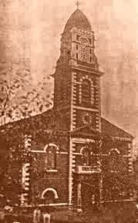
Robert William Edward Bellnap
Born 24th September 1820, baptised 15th October, St. Leonard’s, Shoreditch
Paper stainer, costermonger, colour maker, general dealer, ‘gentleman’.
Married Milbro Sarah Dunnett, 6th August 1838, St Matthew’s Bethnal Green.
Second wife was a match-maker named Emma, and third was Mary Ann Webb (1892), and the fourth Sarah Leach.
Children: Robert (1839), William (c1841) Ann Elizabeth (1843), Charlotte Marianne (1846), Sarah (c1847), Charles Edward (1848), Amelia Sarah (1850), Thomas Richard (c1853), Louisa (1853). Three died in infancy.
Died 9th March 1897, aged 76.
St. Matthew’s, Bethnal Green
Notes:
Born 24th September 1820 and baptised 15th October 1820 at St. Leonard’s, Shoreditch
Various professions: paper stainer (1838-1850), costermonger (1851-1853), colour maker (1863-1870), general dealer (1871-1891) and, finally, ‘gentleman’ (1892).
Married Milbro Sarah Dunnett on 6th August 1838 at St. Matthew’s, Bethnal Green(she died in 1856, aged 39). His second wife was a match-maker named Emma, and his third was Mary Ann Webb (1892).
Nine children: Robert (1839), William (c. 1841) Ann Elizabeth (1843), Charlotte Marianne (1846), Sarah (c. 1847), Charles Edward (1848), Amelia Sarah (1850), Thomas Richard (c. 1853), Louisa (1853). Three of these died in infancy.
Died 9th March 1897, aged 76, and buried in Manor Park Cemetery.

Slide 28
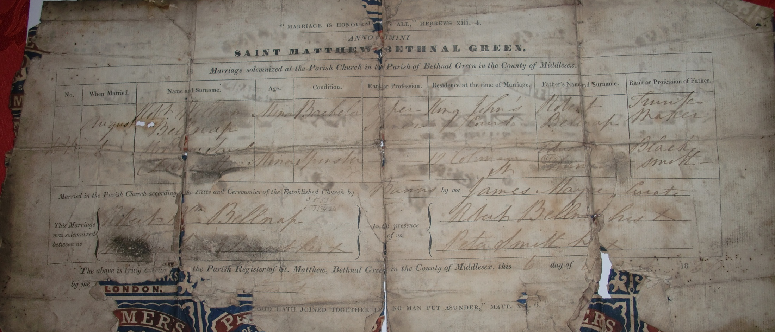

Slide 29
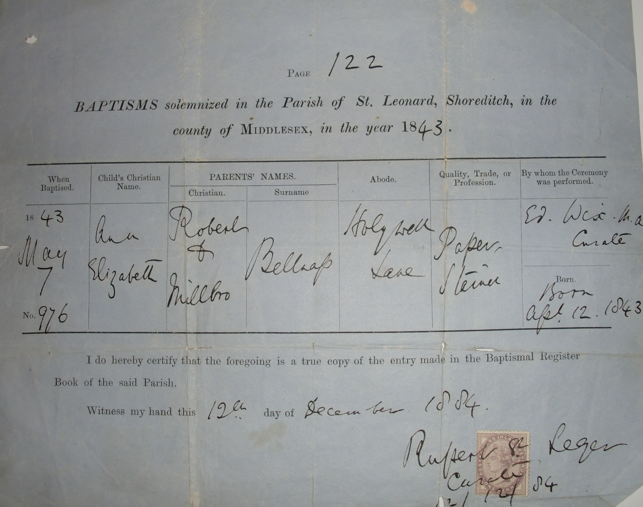

Slide 30
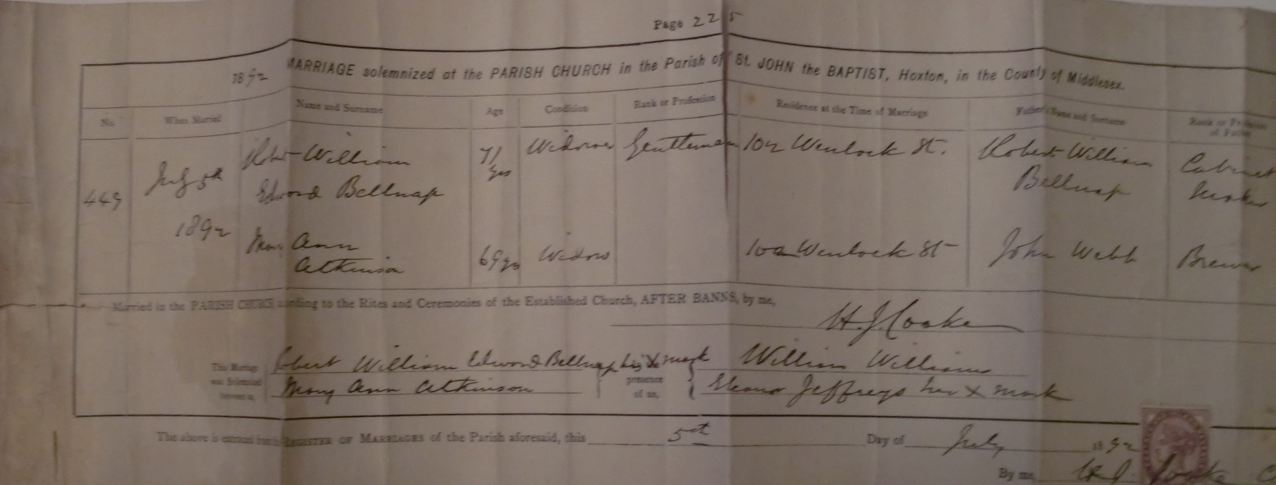

Slide 32
Costermongers
For most of his life, Robert Bellnap worked as a costermonger.
Street-sellers of fruit and vegetables.
Well known for their loud and distinctive street cries.
‘low habits, general improvidence, love of gambling, total want of education, disregard for lawful marriage ceremonies, and their use of a peculiar slang language’ (John Camden Hotten, 1859)
The character of the costermongers was later popularised in the music halls by comedians such as Albert Chevalier and Gus Elen.
Notes:
For most of his life, Robert Bellnap worked as a costermonger.
Street-sellers of fruit and vegetables in London during the 19th century.
Well known for their loud and distinctive street cries.
They gained an unsavoury reputation for their ‘low habits, general improvidence, love of gambling, total want of education, disregard for lawful marriage ceremonies, and their use of a peculiar slang language’ (John Camden Hotten, 1859)
They also showed frequent hostility to the police and other authority.
The character of the costermongers was later popularised in the music halls by comedians such as Albert Chevalier and Gus Elen.

Slide 33
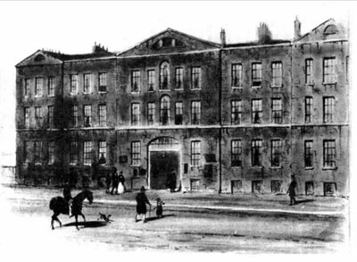
Shoreditch Workhouse
In 1861 Robert Bellnap and family were inmates at Shoreditch Workhouse.
Workhouses were state institutions for the relief of the poor and unemployed, with basic food and accommodation.
Life in a workhouse was intentionally harsh and uninviting. Able-bodied inmates were given hard labour such as stone-breaking or picking oakum.
Families split up; parents only permitted to see children one hour on Sunday afternoon.
Shoreditch Workhouse was built in 1777, but rebuilt in 1863 –still hospital today.
Notes:
In 1861 Robert Bellnap and family were inmates at Shoreditch Workhouse.
Workhouses were institutions provided by the State for the relief of the poor and unemployed, and provided extremely basic food and accommodation.
Life in a workhouse was intentionally harsh and uninviting. Able-bodied inmates were given hard labour such as stone-breaking or picking oakum.
Families were split up in the workhouse, with parents only being permitted to see their children for one hour on a Sunday afternoon.
Shoreditch Workhouse was built in 1777, but rebuilt in 1863 – it still stands as a hospital today.

Slide 34
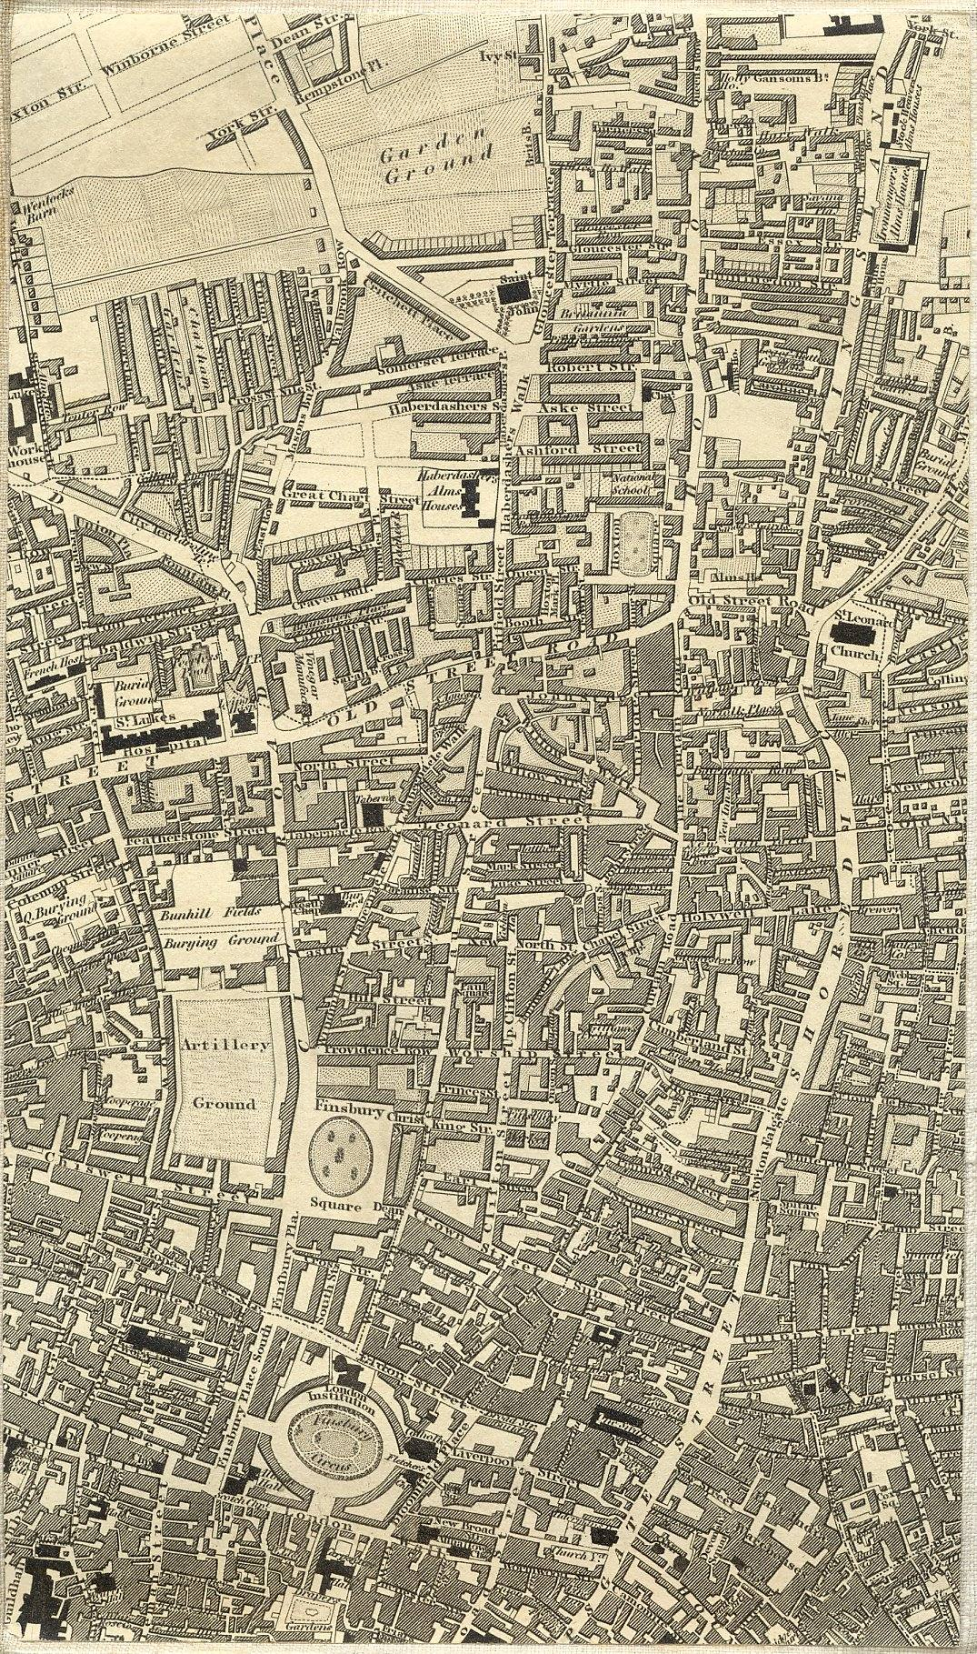
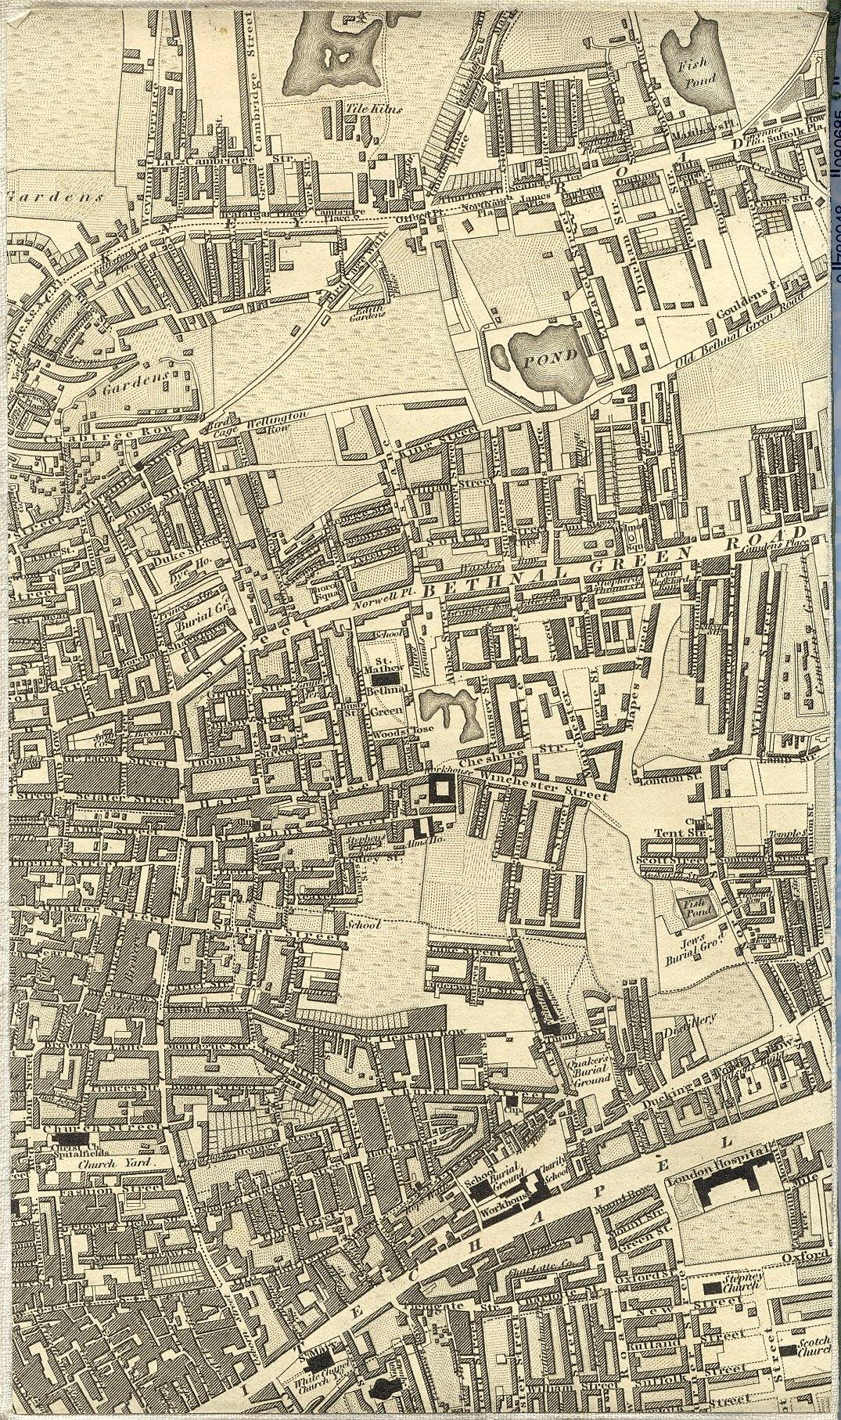

Slide 35
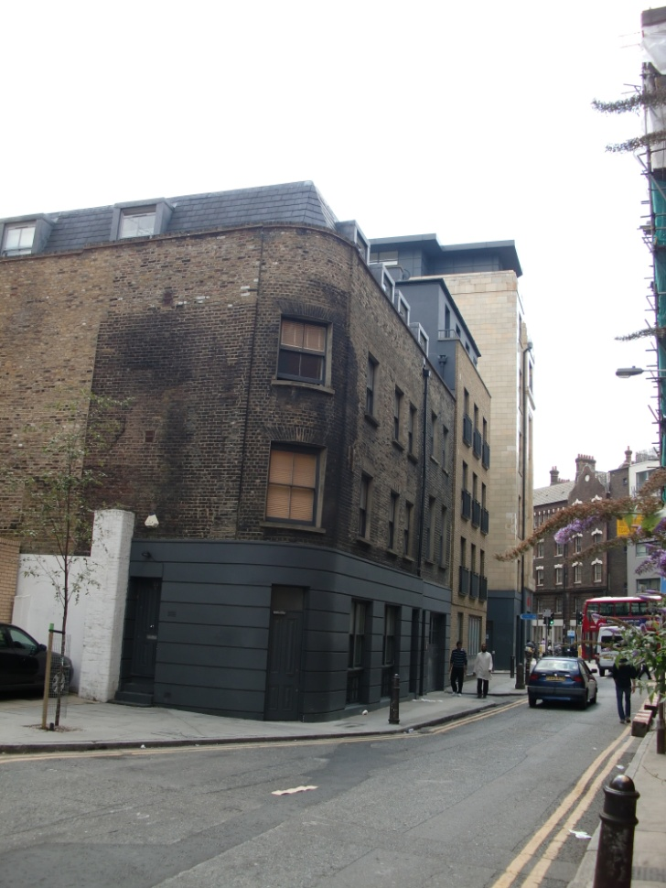
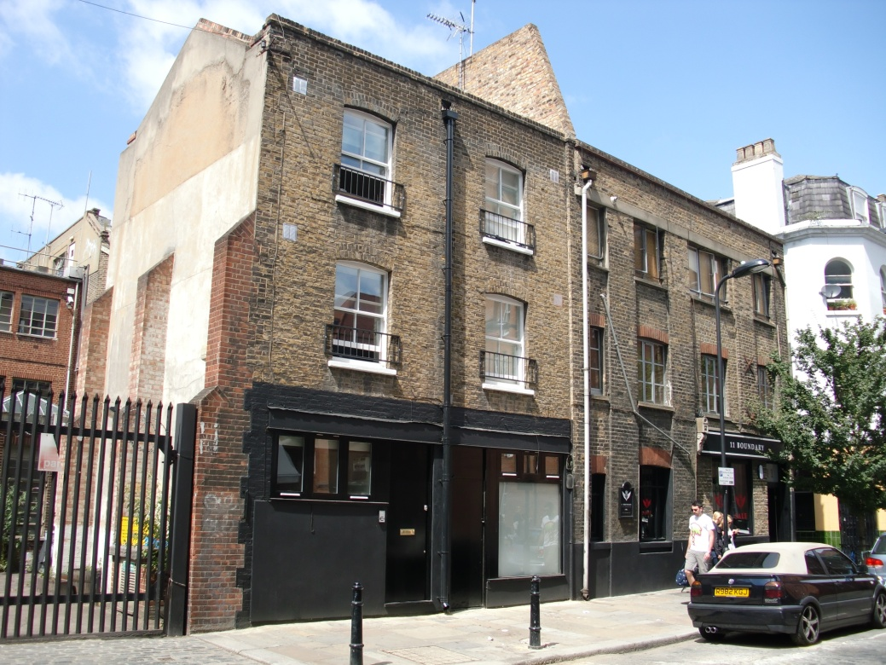
Spitalfields residences
The 1871 census records that the Bellnaps were living at 28 Wheler Street, Spitalfields, sharing their house with three other families, and in Boundary Street in 1891.

Slide 36
BELNAPS IN UK CENSUS 1841-1901

Slide 37
From the Belnaps to us
1838
Robert William Edward Bellnap m. Milbro Sarah Dunnett (1820-1897) (1817-1856)
1863
1870
James Flowerday m. (1834-1905)
Ann Elizabeth Bellnap Amelia Sarah Bellnap (1843-1902) (1850-1910)
m. Thomas Samuel Entwistle (1853-1936)
1898
James Thomas Flowerday married Sarah Entwistle (1875-1949) (1879-1950)
1920
Sarah Elizabeth Flowerday m. James Alfred Griffiths (1899-1992) (1899-1971)
1951
Irene Sarah Griffiths m. Sidney Harold Dixon (1924-) (1923-)
Since the Belnap male line has died out in England, our family is the closest thing to it. The only person in Britain with the surname Belnap is a Canadian.
1982
Graham Peter Dixon m. Helen Audrey Jefferson (1956-) (1954-)
Nicholas Andrew Dixon (1992-)

Slide 38
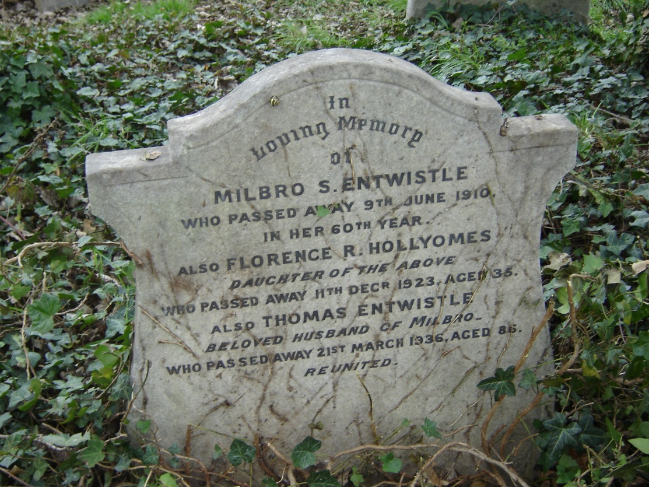

Slide 39
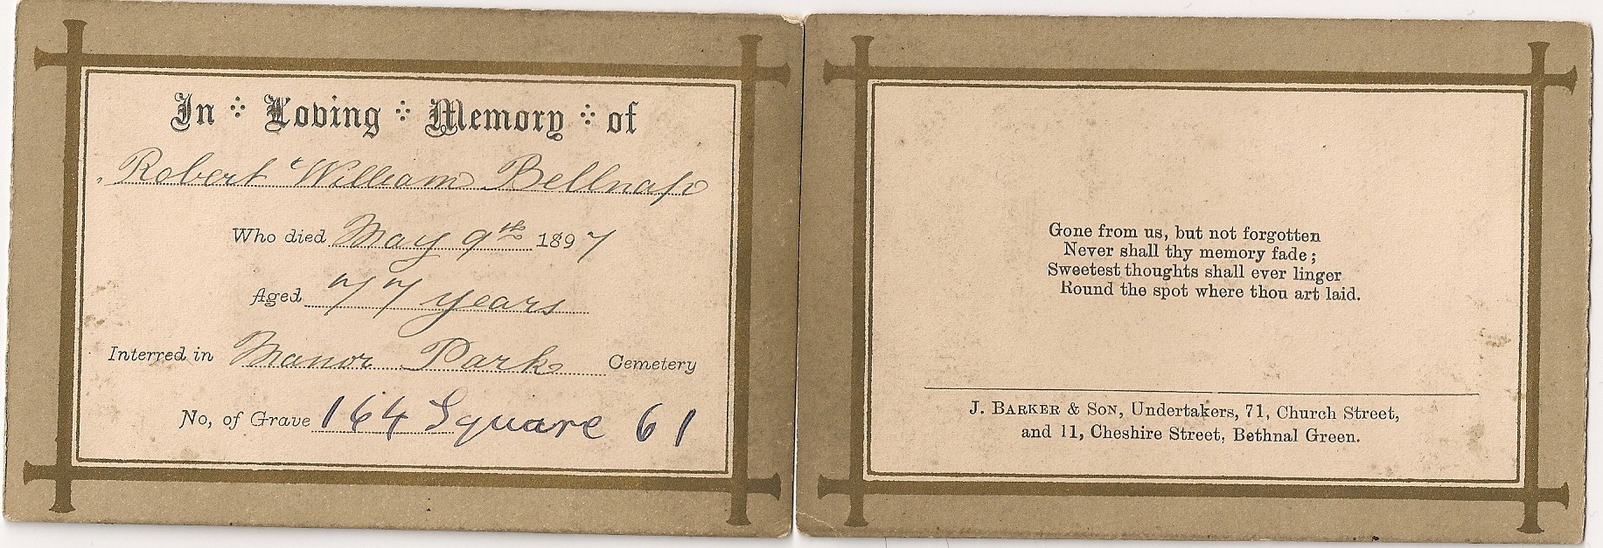

Slide 40
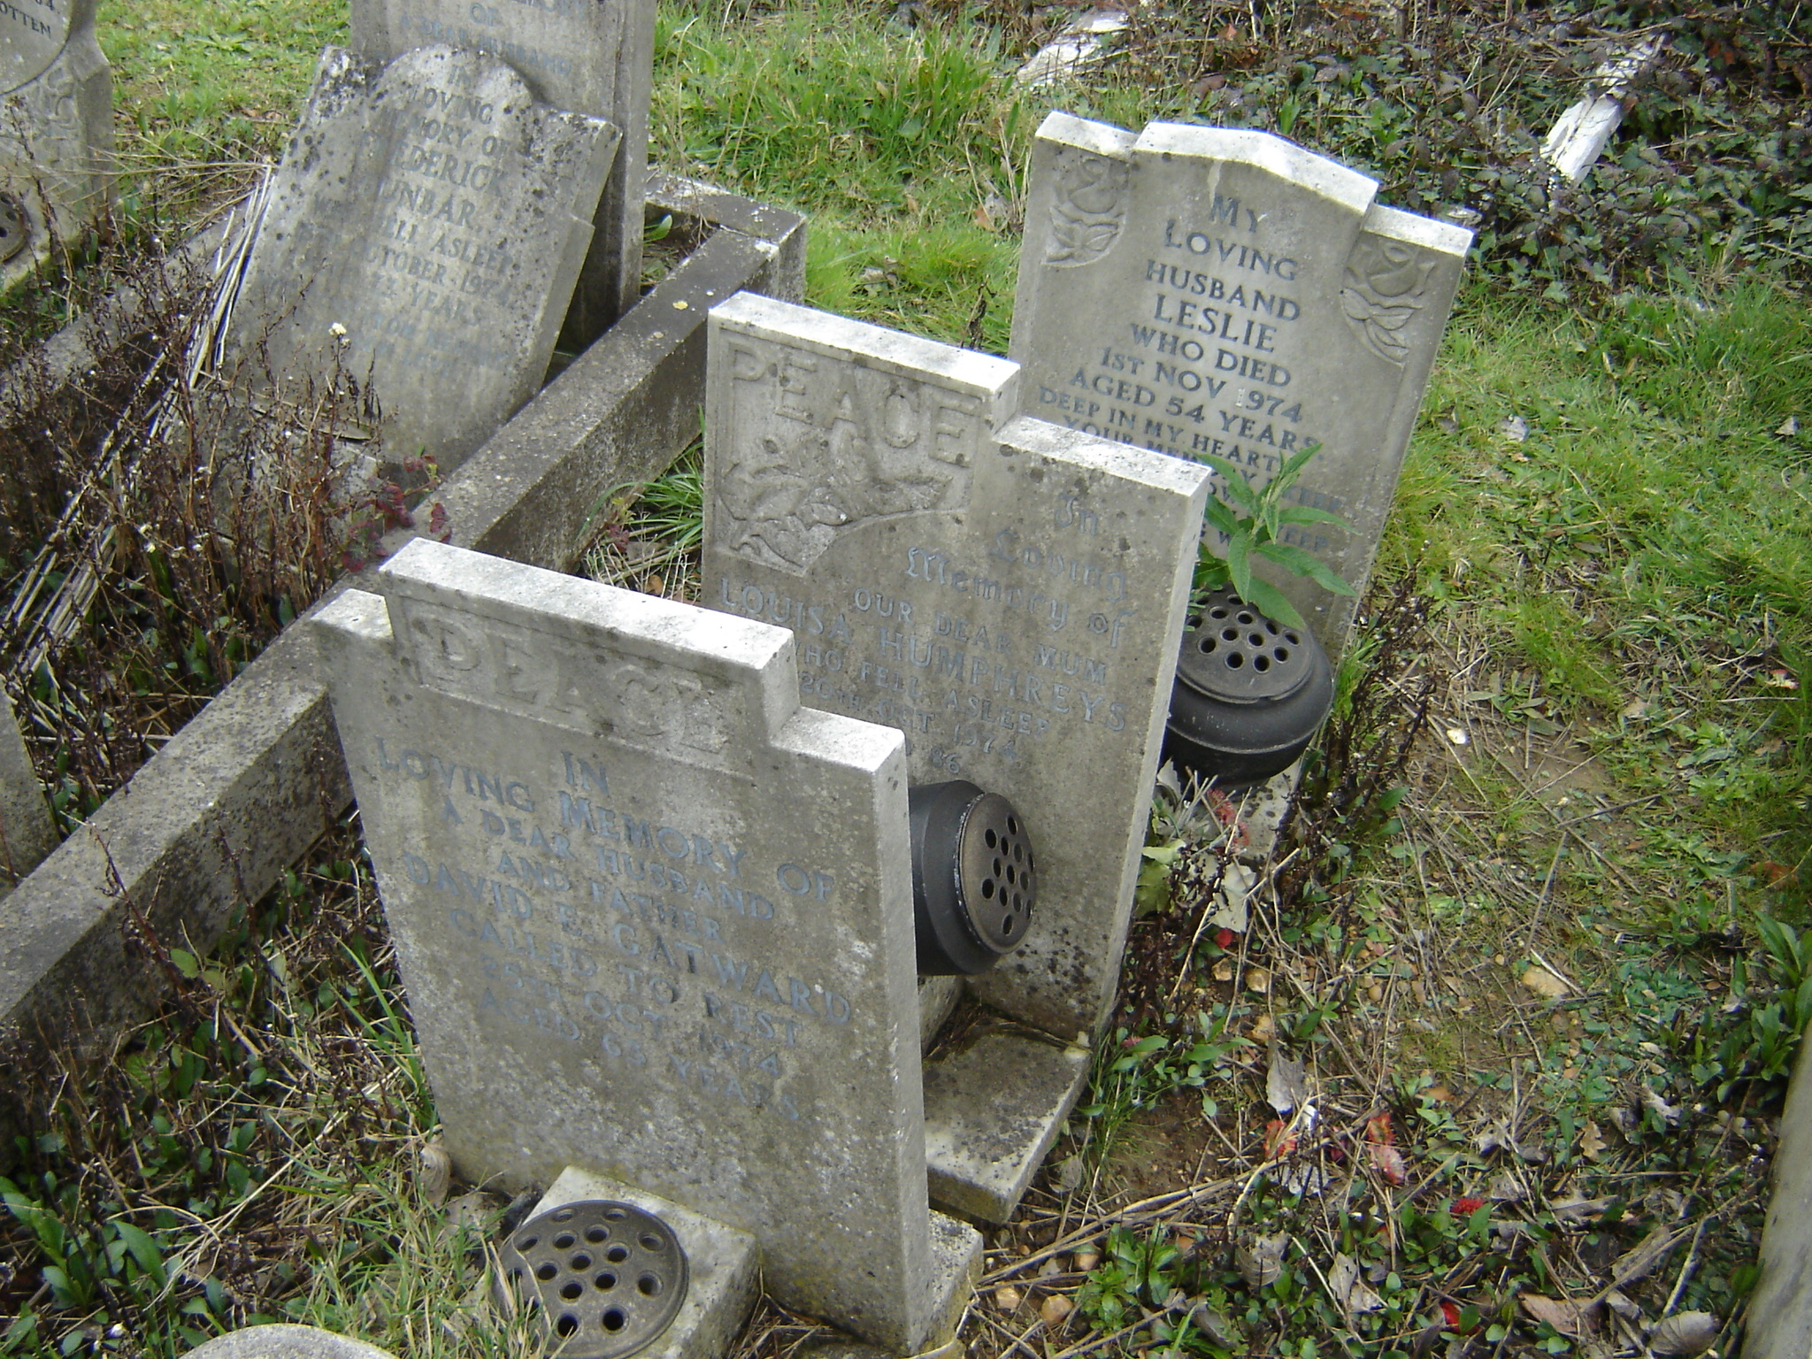

Slide 41
A message from Mrs Irene Dixon…

