Slide 1

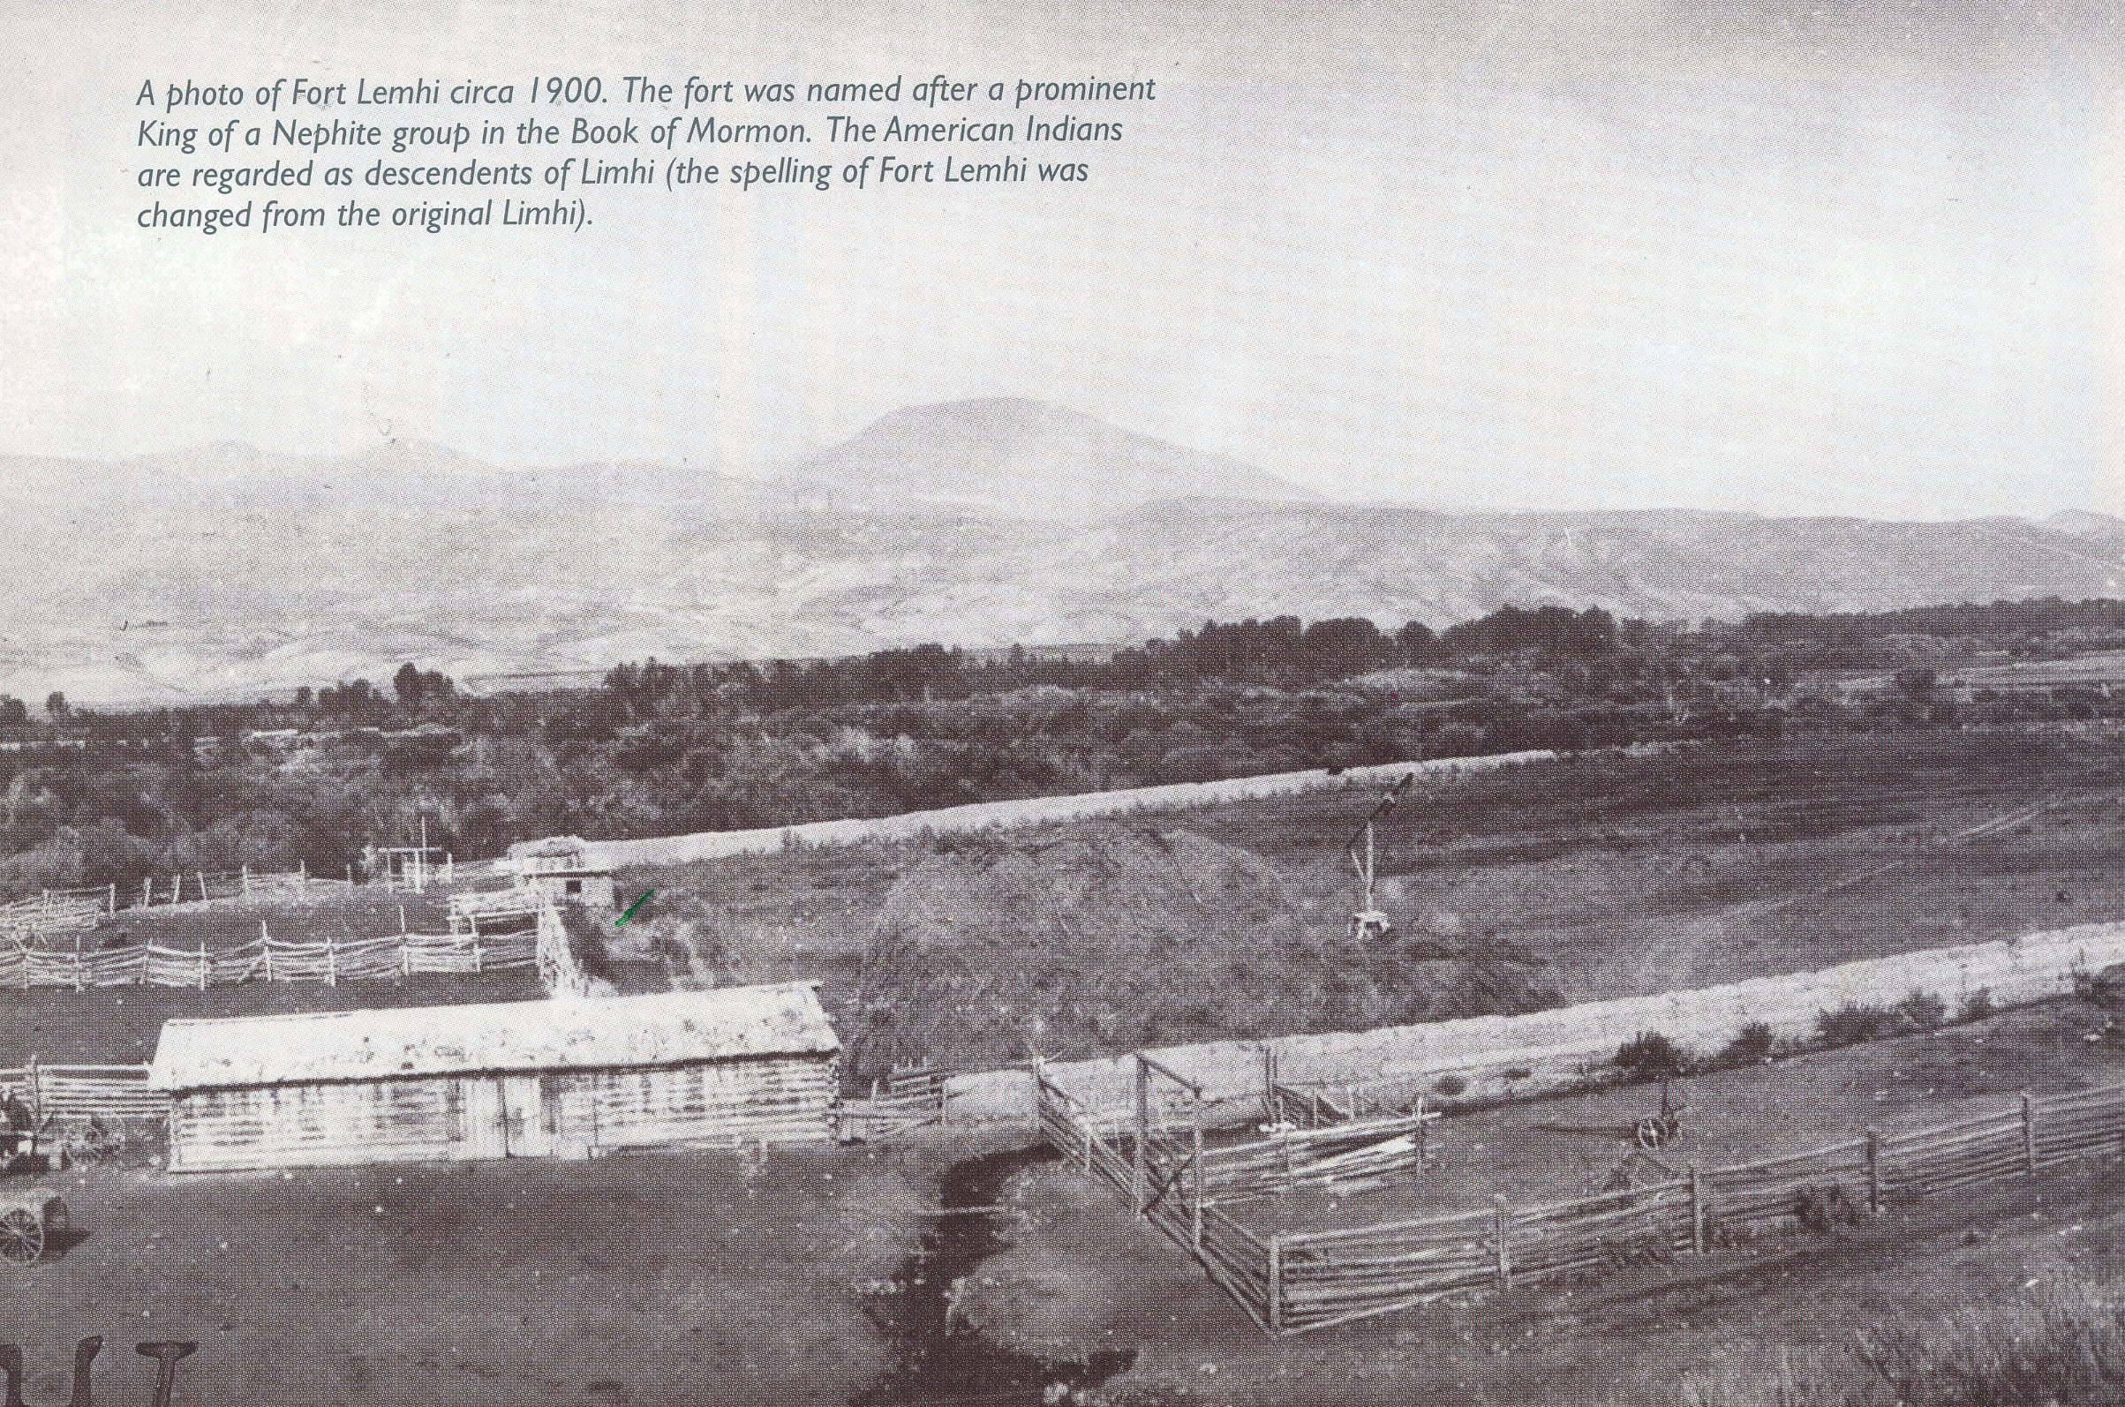
FORT LEMHI

Slide 2
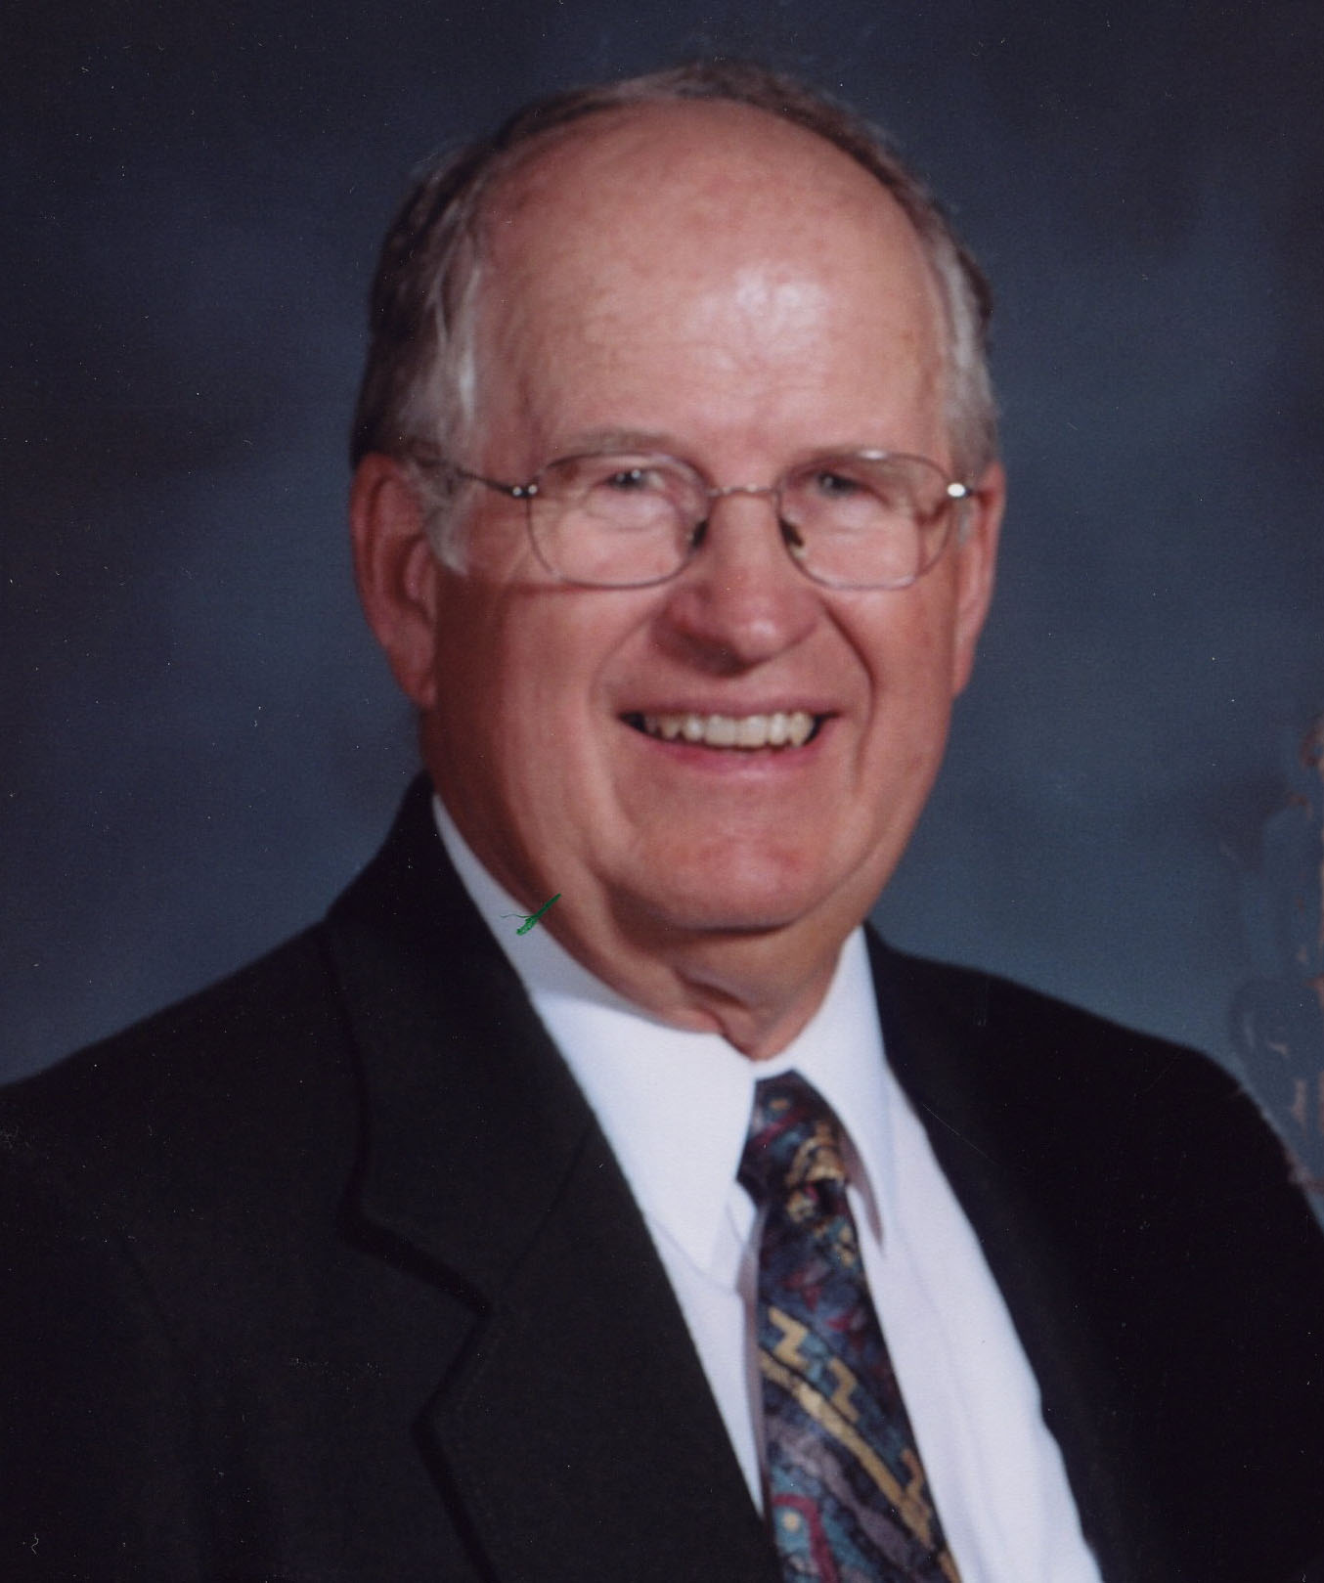
Jim Marriott Born Dec. 10 1934
Ogden Utah

Slide 3
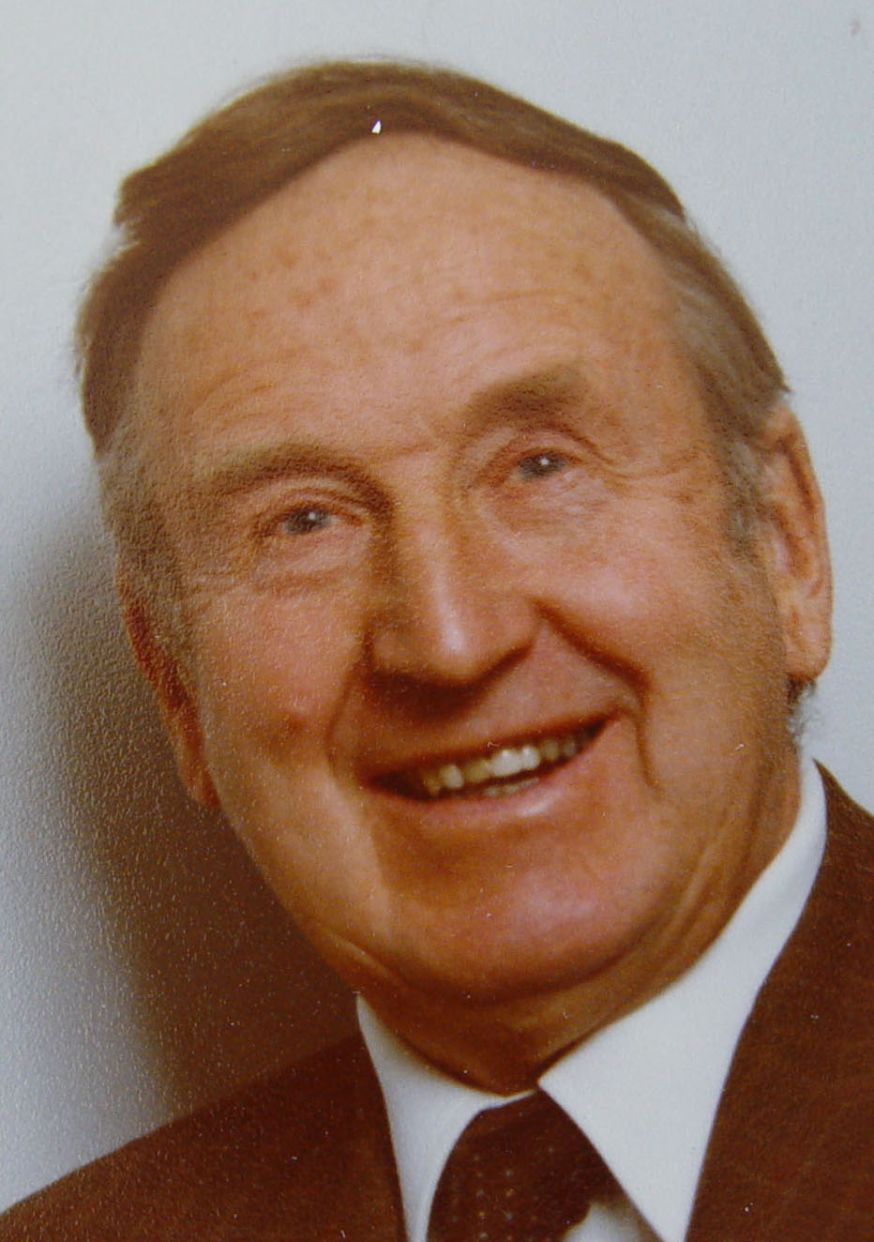
Born Nov 15 1909
Ogden Utah
Died 21 Jan 1980
Ogden Utah
Gilbert Enos Marriott

Slide 4
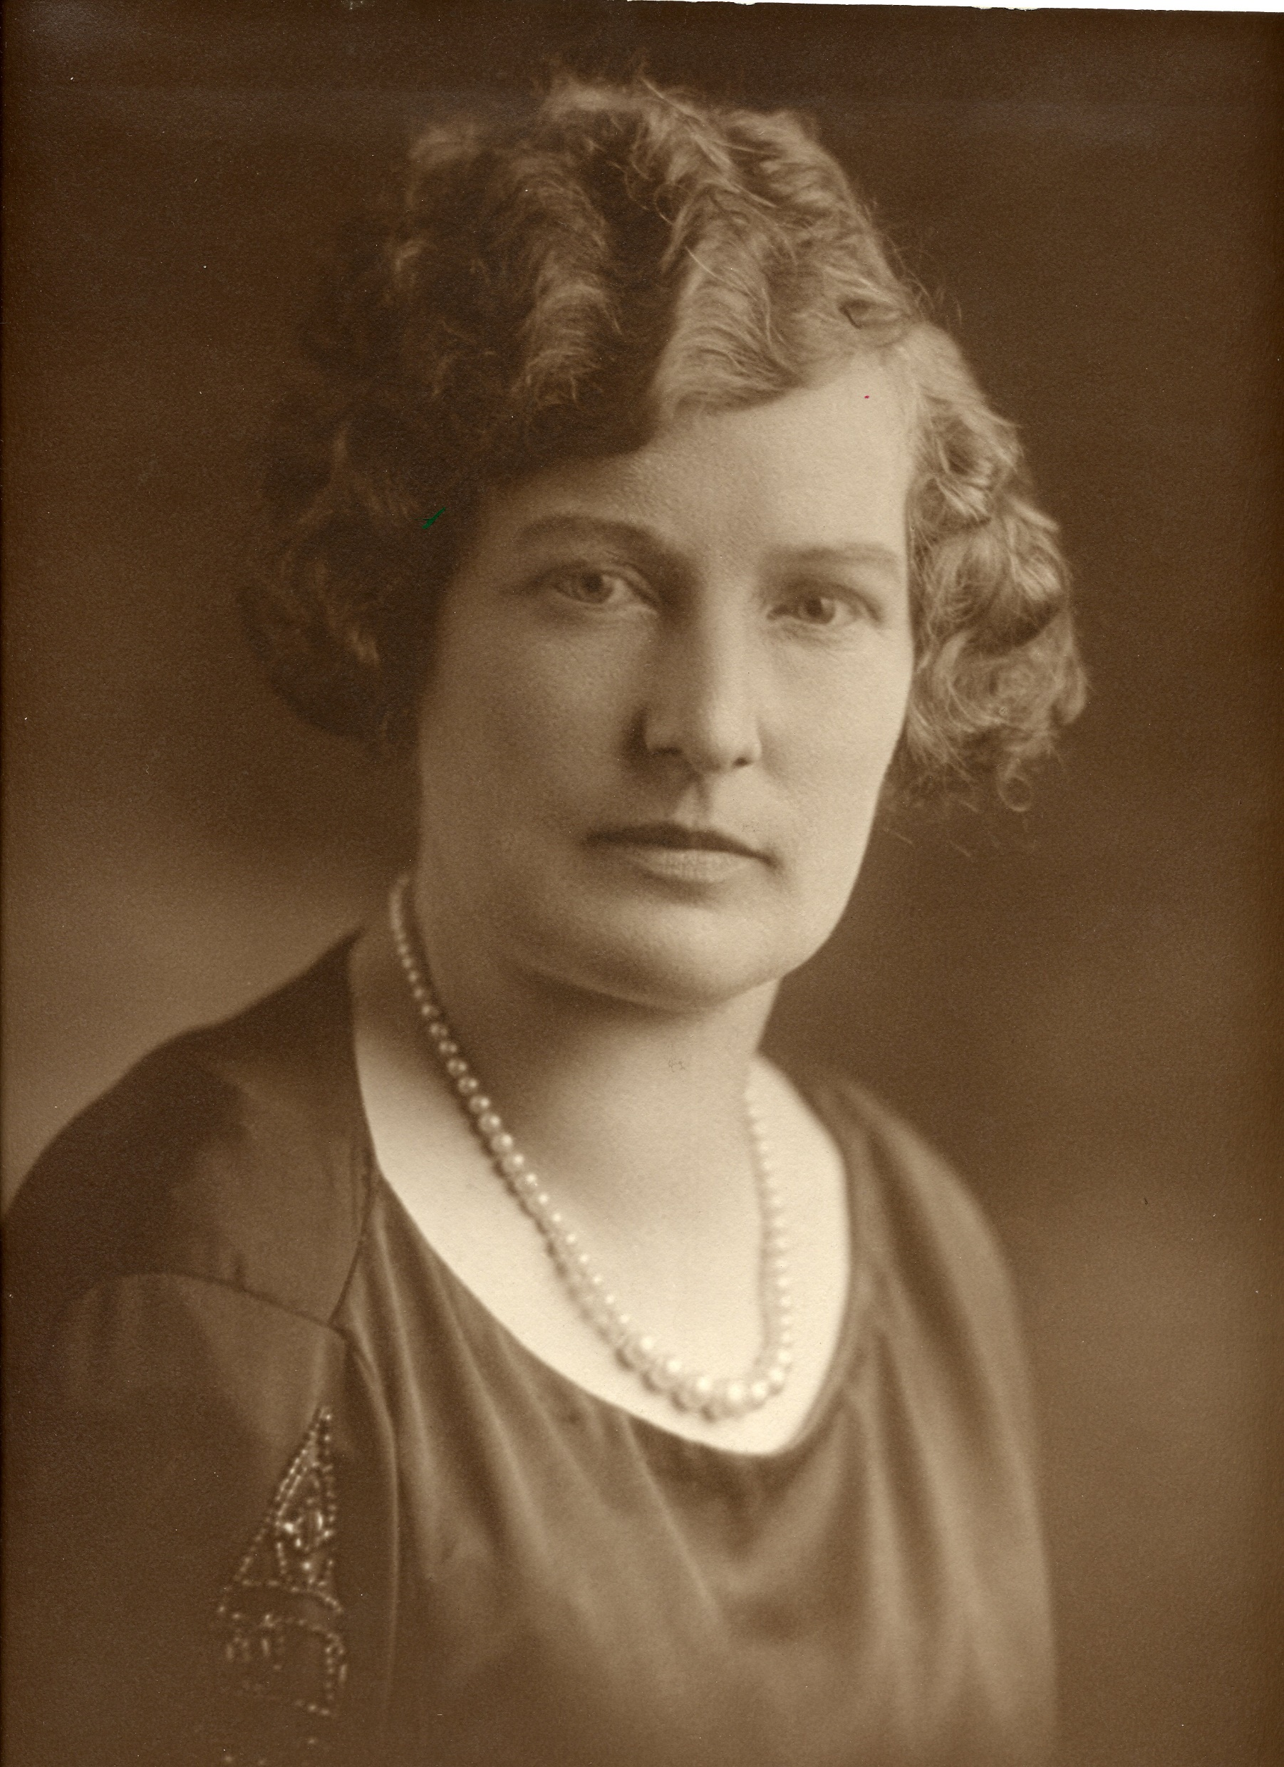
Weltha Belnap
Born 27 July 1886
Ogden, Utah
Died 18 July 1923
Ogden Utah

Slide 5
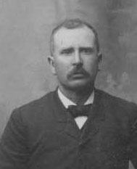
Gilbert Rosel Belnap
Born 8 Jan 1847 Winter Quarters, Nebraska
Died 25 Jan 1929 Ogden Utah

Slide 6
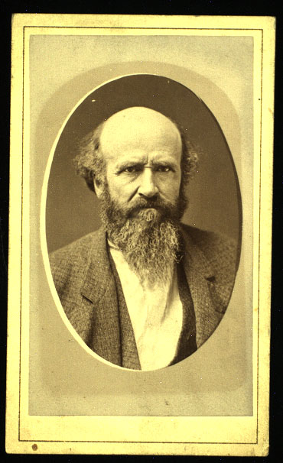
Born 22 Dec 1821
Port Hope,NCD
Canada
Died 26 Feb 1899
Hooper, Utah
Gilbert Belnap our common ancestor

Slide 7
Gilbert Belnap the Missionary to the Lamanites 1855
Gilberts journal
At the April conference was appointed on a mission to the house of Israel.
I was set apart in Ogden City April 26th 1855 under the hands of Lorenzo
Snow.
On the 15th of May dedicated myself and family to the Lord. And on the
16th took leave of friends and family, with eleven wagons and twenty
Seven men. Thomas S. Smith President

Slide 8
Members of Pioneer Party
Ames, Ira
Gallagher, John
Taylor, Pleasant G.
Barnard, Ezra J.
Grant, George R.
Watts, Baldwin H.
Batchelor, William M.
Hill, George W.
Zundell, Abraham
Belnap, Gilbert R.
Leavitt, Nathaniel
Browning, John W
* With wife and
family
Lish, Everet *
Bundridge, William L
McGary, Charles *
Birch,William
Moore, David
Secretary
Burgess, William
Butterfield, Thomas
Parry, Joseph
Clark, Israel J. *
Shepherd, Isaac
Cummings, Benjami F.
Capt of Guard
Stevens, David M.
Dalton, Charles
Smith, Thomas S.
President
Dunfree, Francillo
Capt.

Slide 9
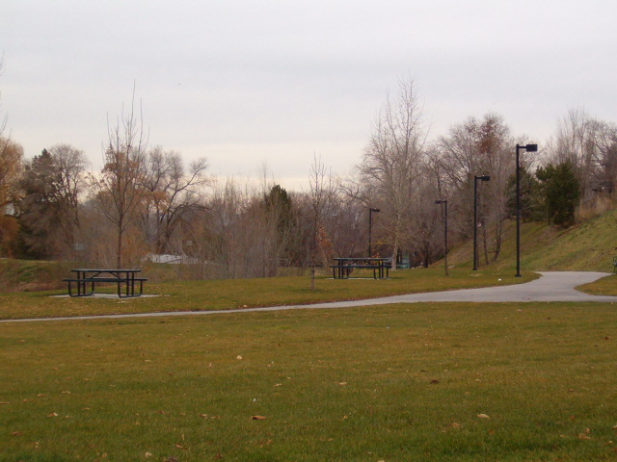
Sullivan Hollow. Gilbert Belnap’s home was in this area.

Slide 10
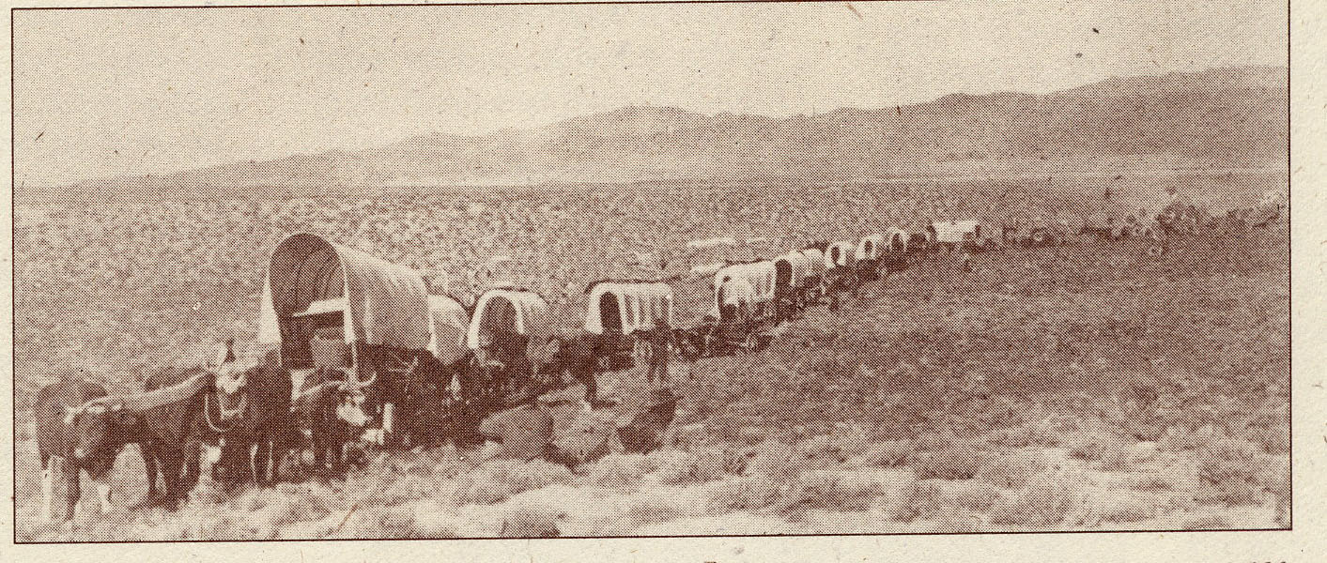
Wagon train

Slide 11
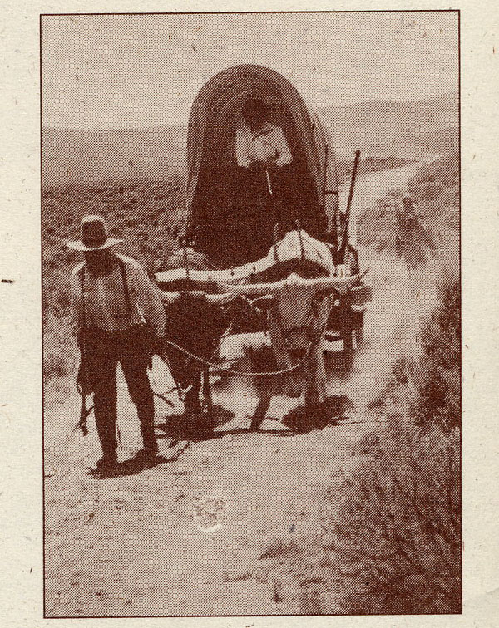
Covered Wagon
Pulled by a
Team of oxen

Slide 12
On May 16 1855 took leave of my friends and family, with eleven wagons
and twenty seven men. Thomas S. Smith President. Camped the first night
at the herd house of Nathaniel Leavitt. 7 miles from home.

Slide 13
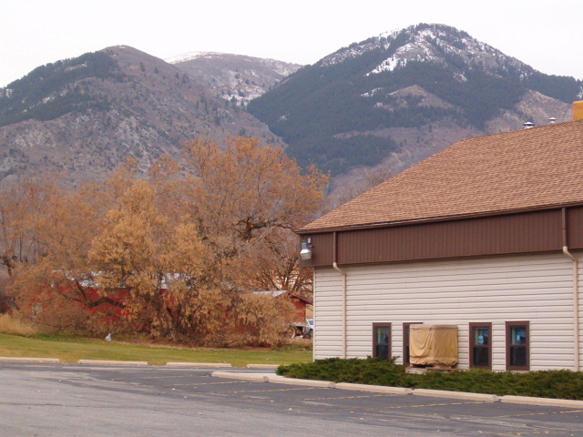

Slide 14
May 17th . Because of the carelessness of G. R. Grant in taking care of
his stock we traveled but five miles and camped at a small springs
west of the road between Willow creek and the Hot Springs of
Ogden Utah.

Slide 15
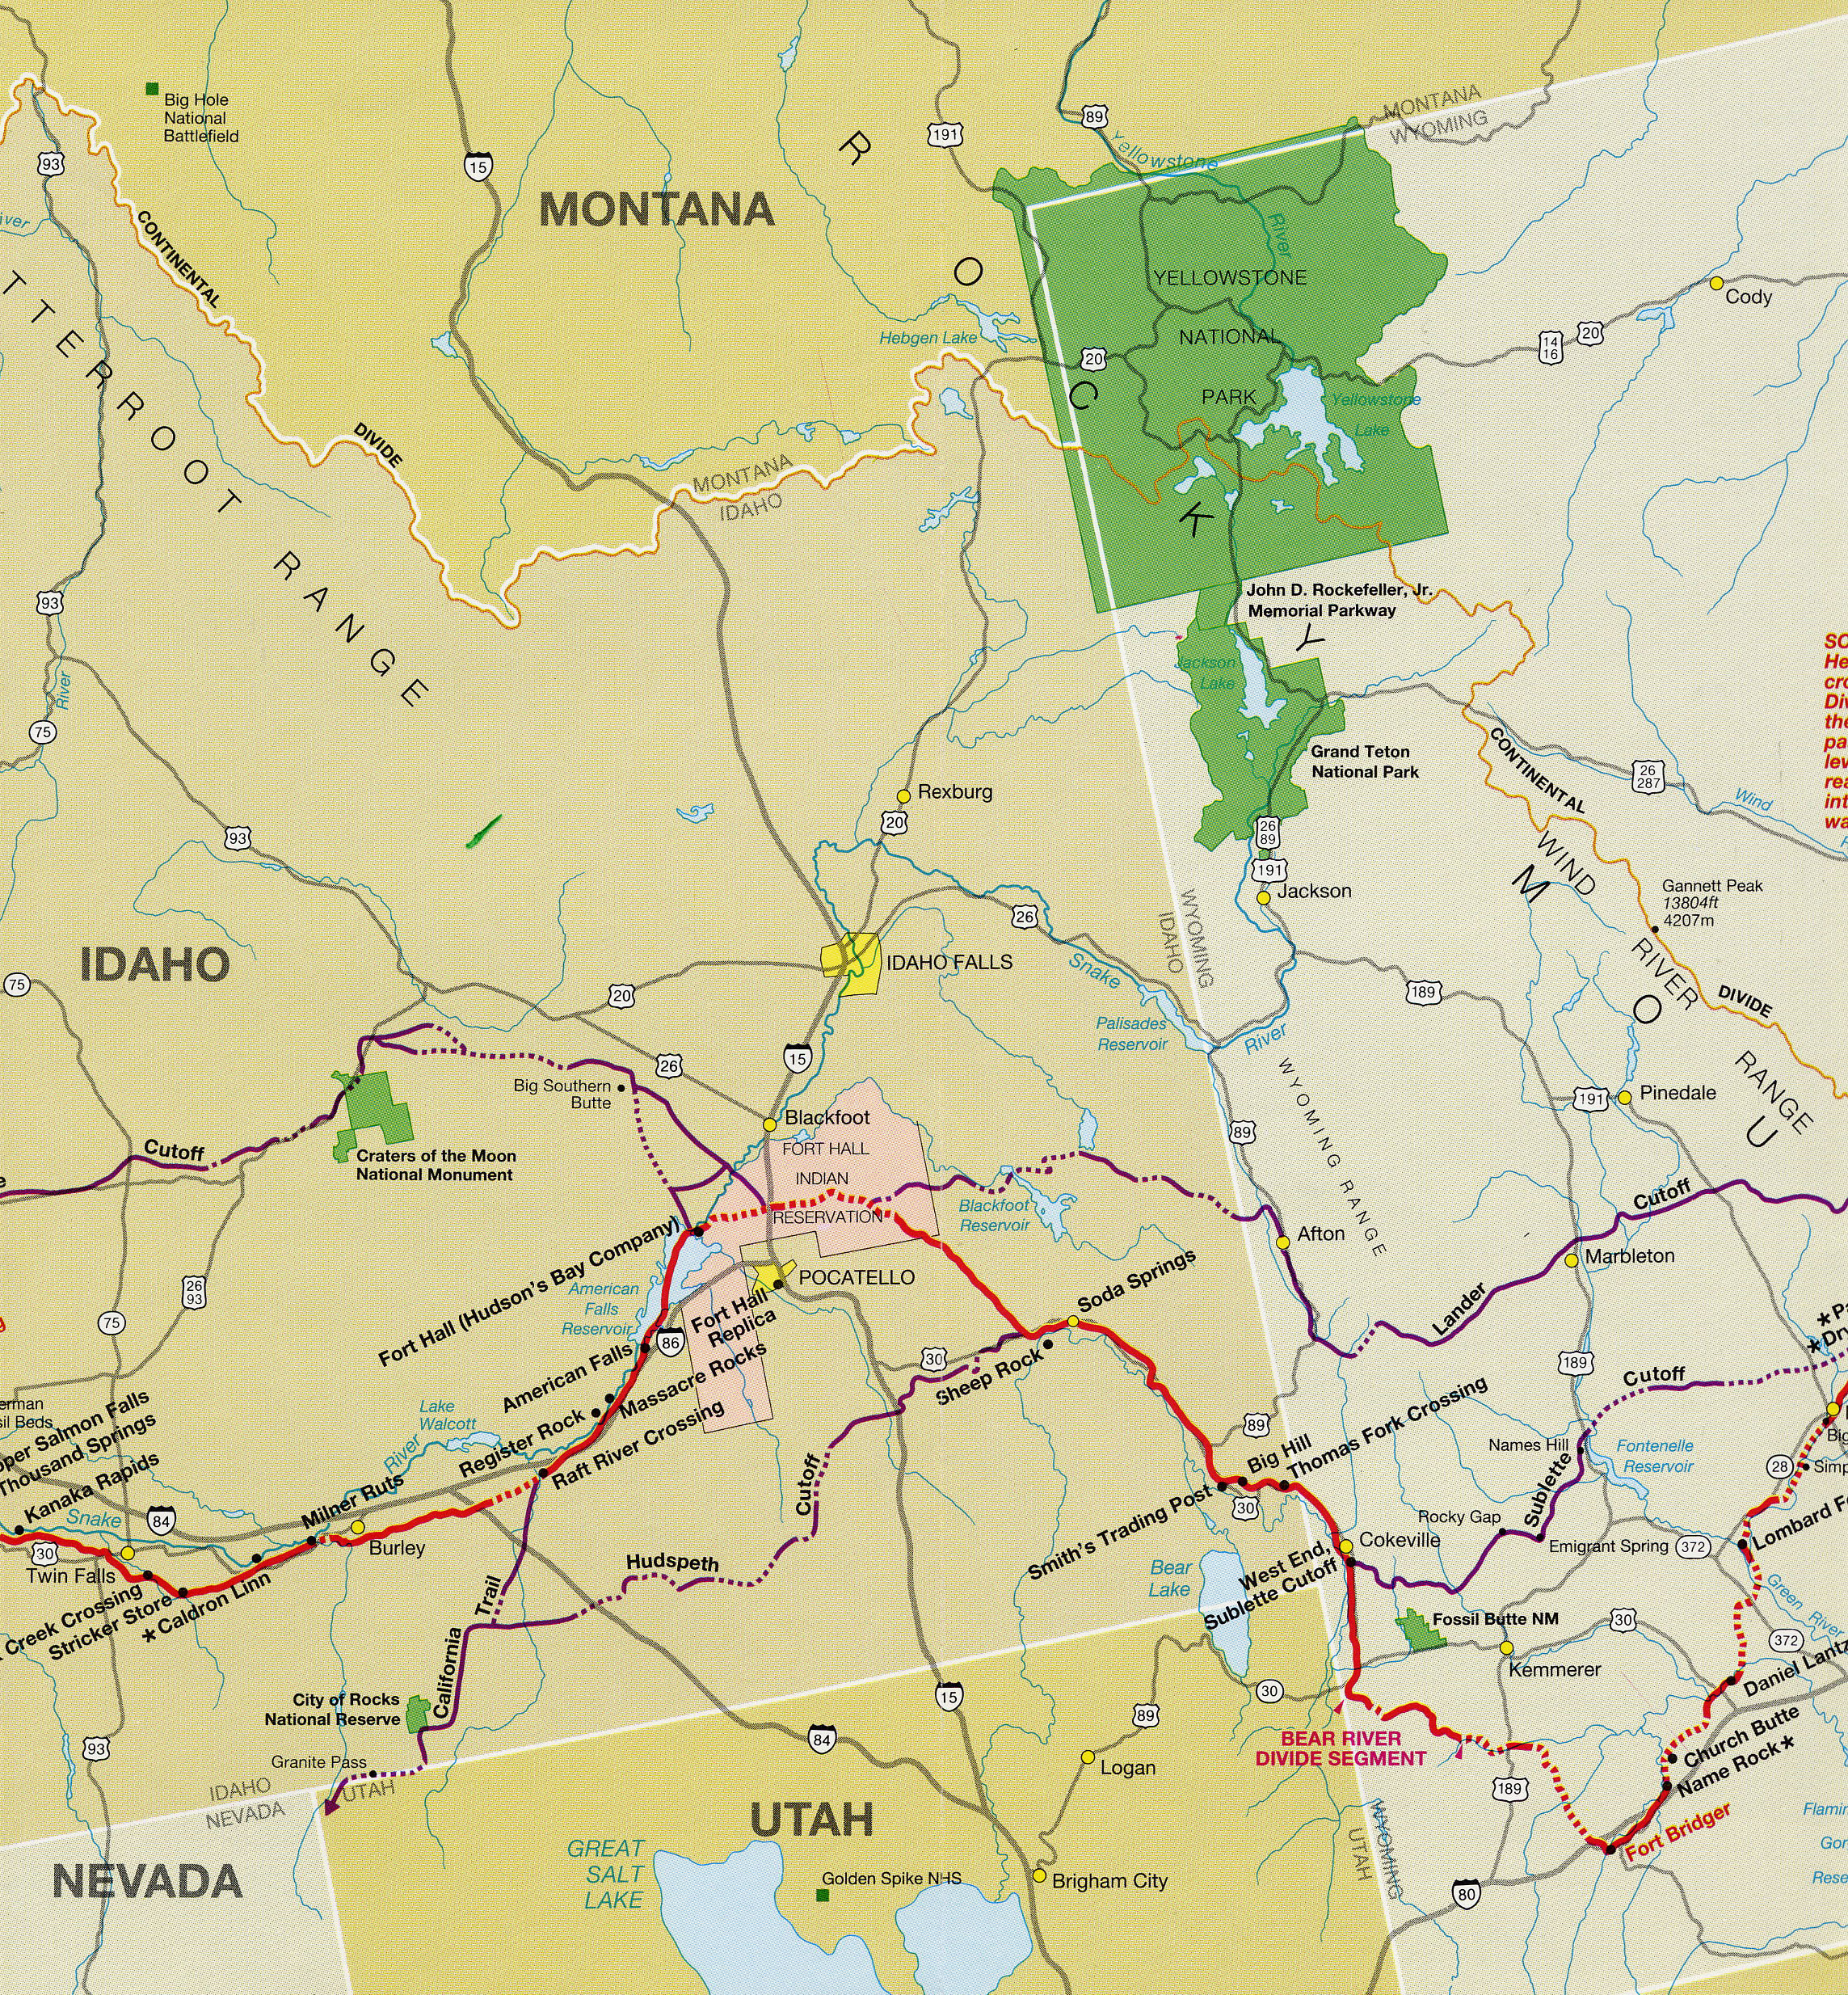

Slide 16
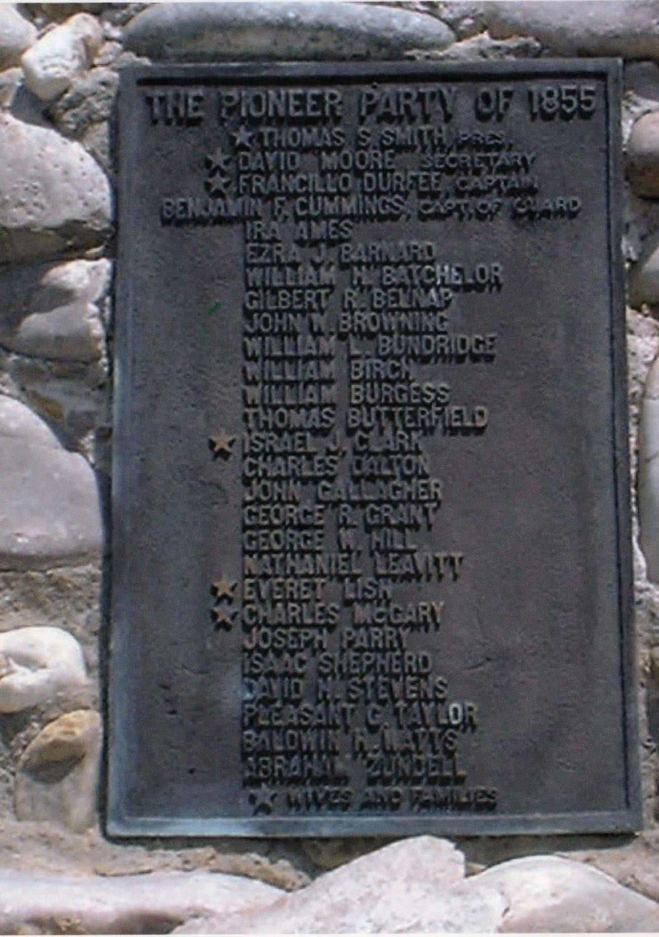

Slide 17
Pioneers to Fort Limhi whose descendants I know
Ezra Barnard and Thomas Butterfield = Judy Kunz of Pingree
Pleasant G Taylor = Bill Taylor of Osgood
Colonist
William Bailey Lake = Jean Esplin and Dennis Lake
Joseph Harper = Steve Bair

Slide 18
May 18th traveled 15 miles and camped at Big Springs, near Joseph Grover
in company with E. Reece train route for carson valley
Big Springs is now called Porter Springs in the town of Perry and is owned
by the family of J Call, the founder of the Flying J Company.
41 degrees, 28 minutes, 20 seconds North Latitude
112 degrees, 2 minutes, 3 seconds, West Longitude
Greenwich England, Elevation 4300 ft

Slide 19
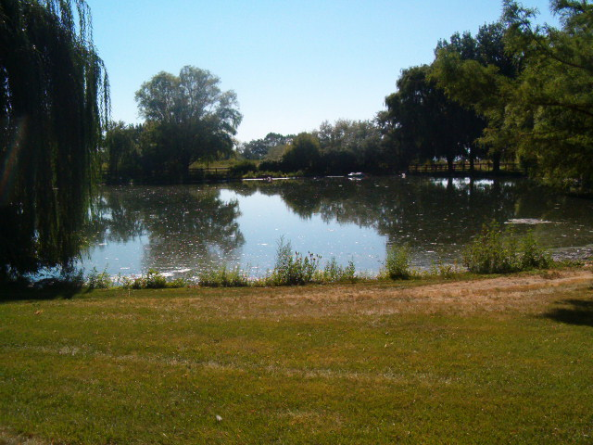
Porter Springs on south side of Call home

Slide 20
May 19th traveled six miles and crossed Bear River free of cost. John Simson
Proprietor.
Elder O Hyde, Marshall Haywood and George P. Styles, United States Judge
For the third Judicial District of the Territory of Utah, camped with us tonight
I also witnessed the crossing of Middleton and Riley’s large herd of cattle.
The swearing and cursing of drivers was disgusting to the ear of every
honorable man.
41 degrees, 32 minutes, 45 seconds North Latitude
112 degrees, 5 minutes, 47 seconds West Longitude
Greenwich England. Elevation 4226 feet

Slide 21
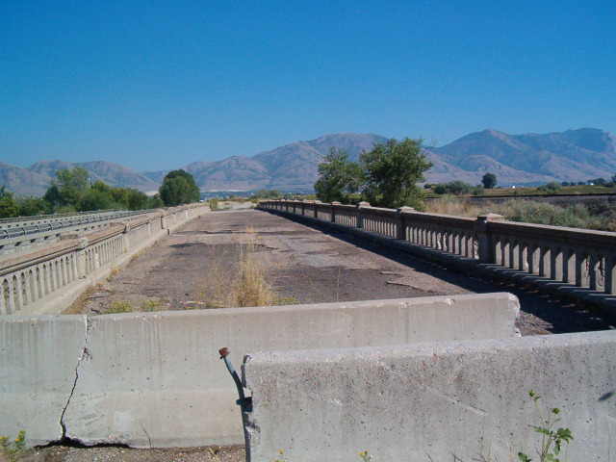
Old bridge crossing Bear River at Corrine

Slide 22
Sunday May 20th, organized in the following order: Francillon Durfey, Captain;
David More, First Lieutenant, B. F. Cummings, Sergeant. Traveled ten miles
and camped near the old ferry on Bear River.
This crossing was scouted out by John C Fremont and he designated it as a natural
crossing because of the slope of the banks on both sides of the river.
There was two crossing at the ferry. One for the ferry and one up stream
a quarter of a mile called the Hensley crossing. This was an alternative to the
ferry.
Hensley coordinates
41 degrees, 46 minutes 17 seconds North Latitude
112 degrees, 7 minutes, 25 seconds West Longitude
Greenwich England. Elevation 4246 feet

Slide 23
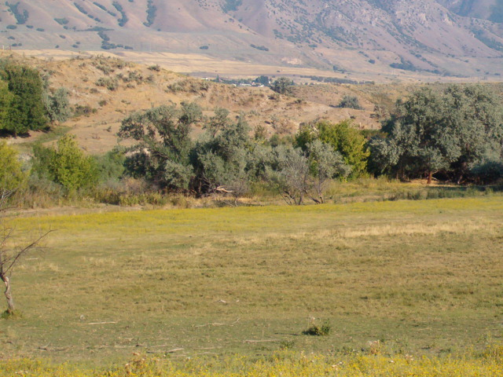
Trail coming down to the Hensley crossing from the East

Slide 24
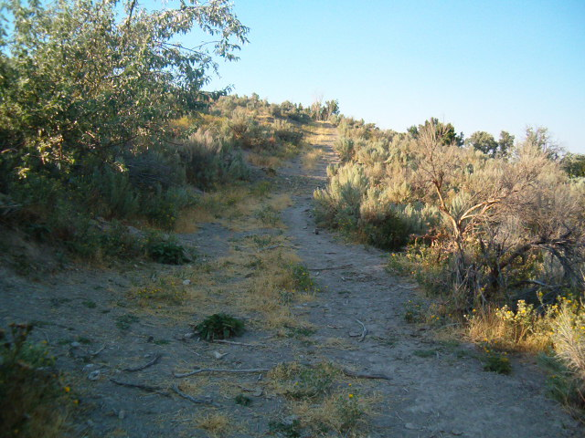
Looking up the trail on the west side of the Hensely crossing

Slide 25
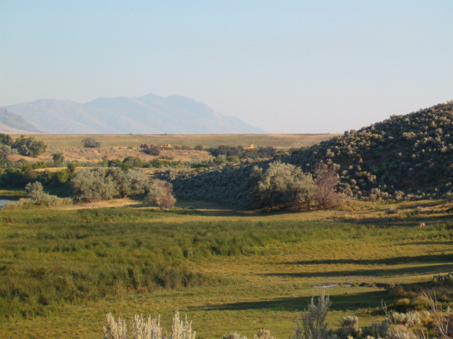
Ferry crossing at the arrow down stream from the Hensley crossing
Looking from West side of Bear River

Slide 26
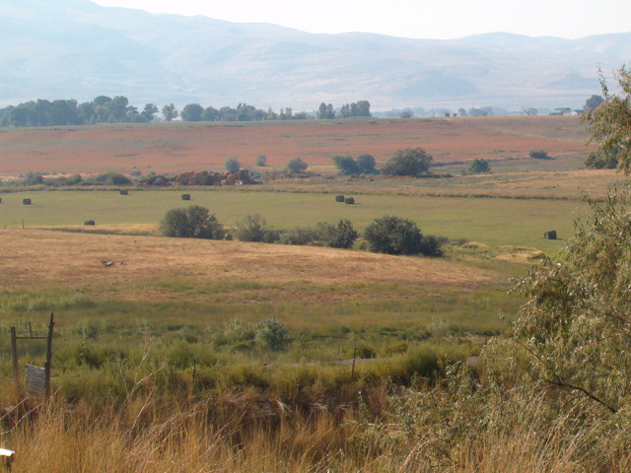
Old Bear River Ferry location

Slide 27
Monday May 21st , traveled 16 miles and camped at Frog springs,
Wind south, cold and cloudy.
Mound springs sets just West of I 15 after you pass the Plymouth exit going
north. Its presently own by Bruce Zundell and has an old home and a new home
next to the springs. Bruce told me that the history of this springs, handed down
through the family is that it was a camping spot for wagon trains headed
north to the gold fields of Montana.
41 degrees, 55 minutes, 6 seconds North Latitude
112 degrees, 10 minutes, 35 seconds West Longitude
Greenwich England. Elevation 4418 feet

Slide 28
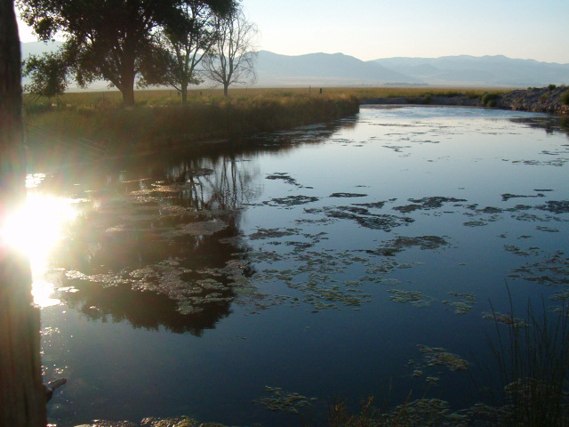
Mound Springs

Slide 29
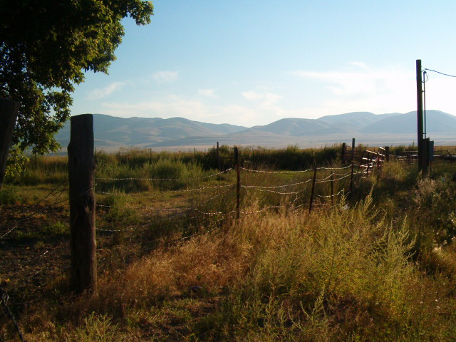
Johnson Canyon pass West of Mound Springs. To the south
of the pass is my great grandfather Moroni Stewart Marriott’s spring
lambing range. (Just a personal note)

Slide 30
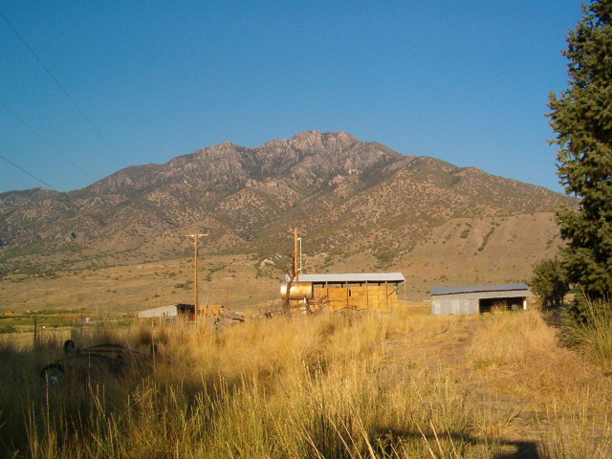
Peak East of Mound Springs

Slide 31
Tuesday, May 22nd . Traveled 18 Miles, weather cold and cloudy,
Camped at the head of Malad. Night rainy
42 degrees, 13 minutes, 16 seconds North
112 degrees, 21 minutes, 54 seconds West
Greenwich England. Elevation 4727 feet

Slide 32
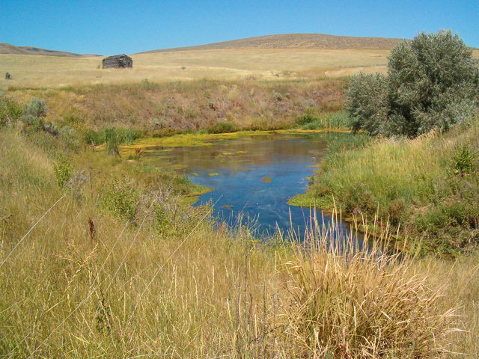
Big Malad Springs Head waters of Big Malad River

Slide 33
Wednesday, May 23rd , Traveled 15 miles, camped on sublets off
At the head of the Malad, Night rainy
42 degees, 22 minutes, 42 seconds North
112 degrees, 27 minutes, 15 seconds West
Greenwich England Elevation 5224 feet

Slide 34
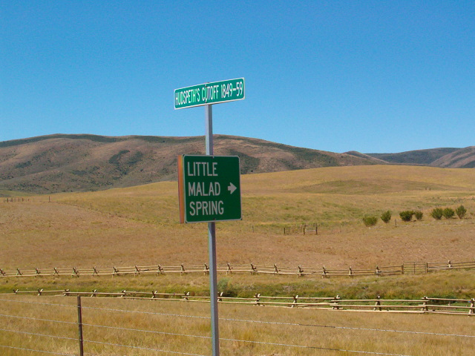

Slide 35
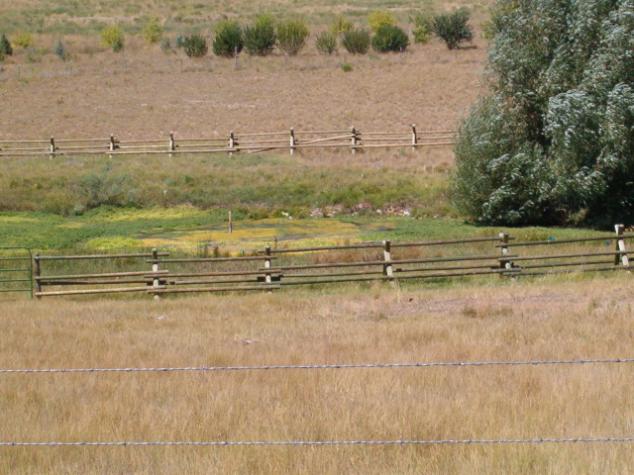
Little Malad Springs, head waters of Little Malad River

Slide 36
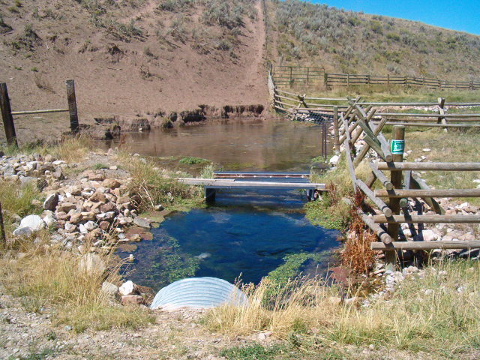

Slide 37
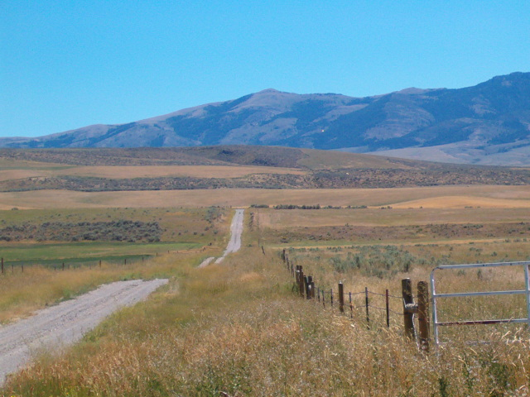
Hudspeth Cutoff mile north of Little Malad

Slide 38
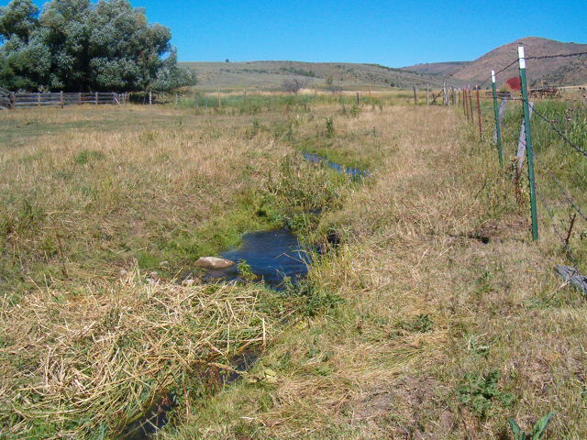
Dairy Creek

Slide 39
Thursday May 24th . Travelled 16 mile, camped at Sandstone Springs
On Old Fort Hall road.
42 degrees, 32 minutes, 03 seconds North
112 degrees, 20 minutes, 23 second West
Greenwich, England. Elevation 5239 feet

Slide 40
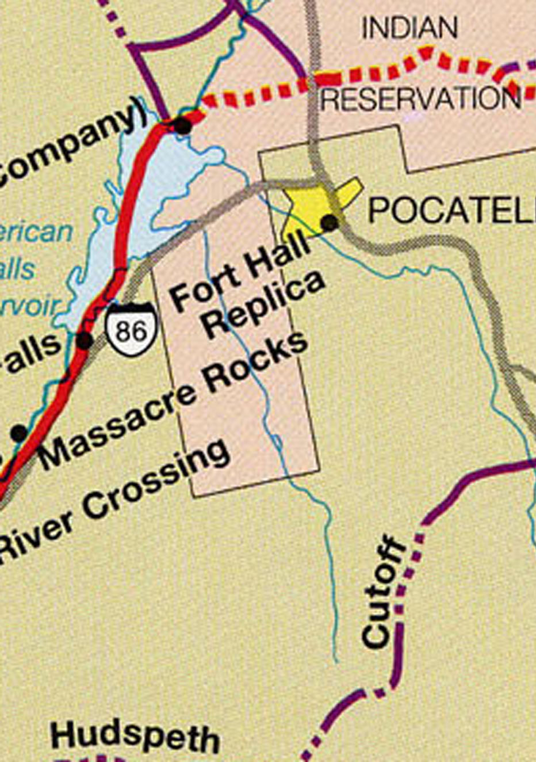
Camp by spring

Slide 41
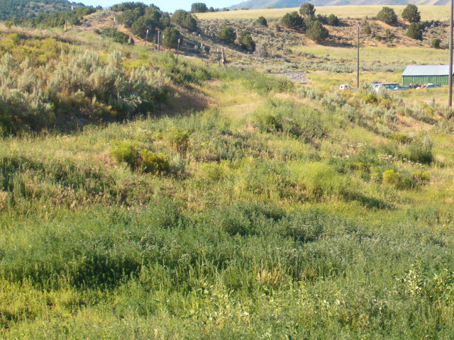
Thursday May 24th, Traveled 16 miles, camped at Sandstone Springs on
Old Fort Hall road
Part of old Hudspeth California cutoff trail
Notes:
O

Slide 42
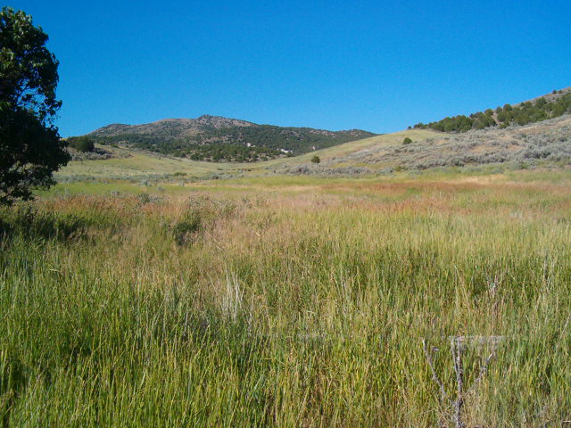
Valley Hudspeth cutoff trail came down

Slide 43
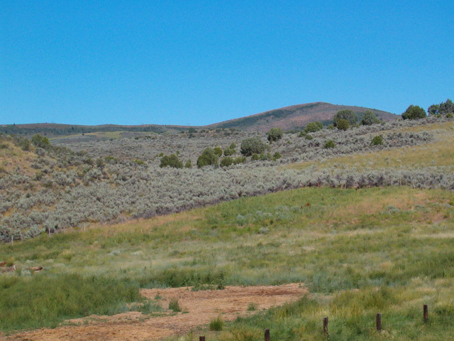
Pass from Hudspeth Cutoff to the head of Rattle Snake Creek

Slide 44
Friday May 25th Remained in camp, Snow and rain nearly all day.
Hard matter to keep the cattle close together
Saturday May 26th Crossed over the mountain and traveled down Crooked
Creek ( now called Rattlesnake Creek) 18 miles and camped at the junction
Of Bannock and Crooked Creek.
42 degrees, 41 minutes, 58 seconds North
112 degrees, 35 minutes, 51 seconds West
Greenwich England. Elevation: 4479 feet

Slide 45
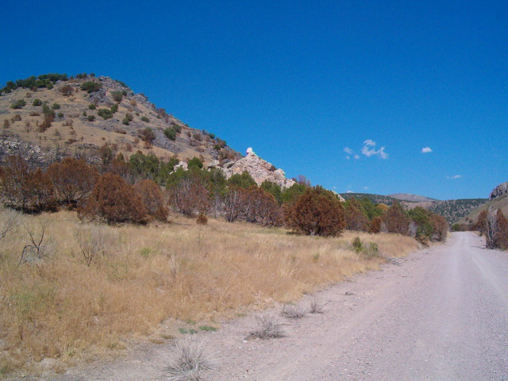
Looking up rattlesnake creek road

Slide 46
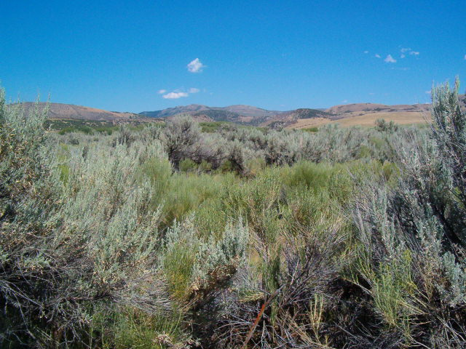
Camp site area at junction of Bannock and Rattlesnake

Slide 47
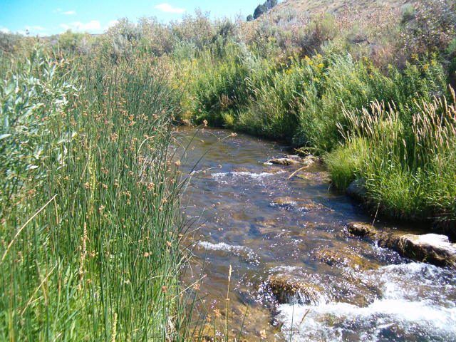
Bannock Creek

Slide 48
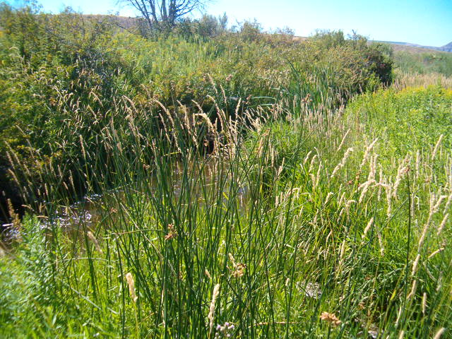
Rattlesnake Creek ( crooked creek)

Slide 49
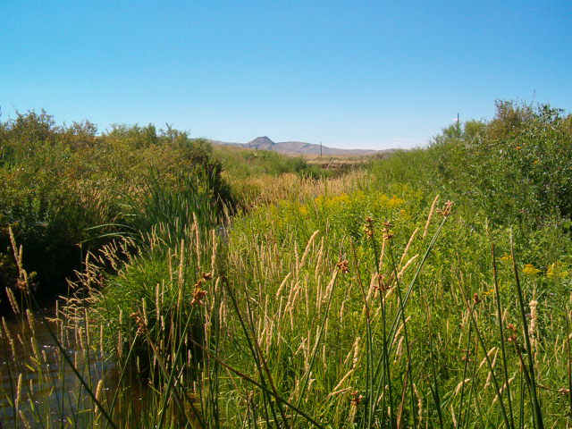
Junction of Bannock and Rattlesnake creeks

Slide 50
Sunday May 27 1855 traveled 18 miles and camped on the bank of the Portniff in full view of Fort Hall

Slide 51
Monday May 28, we travelled six miles and camped at the toll bridge of McArthur.
The toll was one dollar per wagon.

Slide 52
Tuesday May 29th Traveled 18 miles, camped at ferry on Snake River
43 degrees, 01 minutes 13 seconds North
112 degrees, 38 minutes, 04 seconds West
Greenwich, England. Elevation: 4375 feet

Slide 53
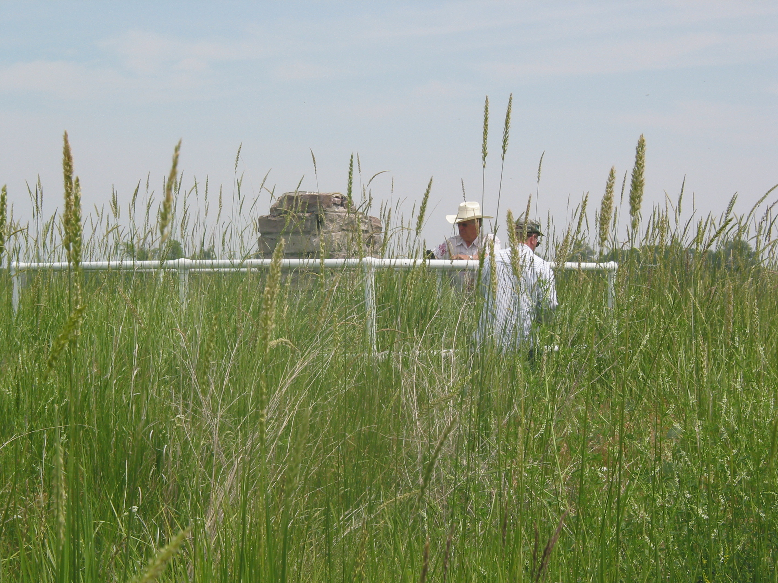
Monument at Old Fort Hall

Slide 54
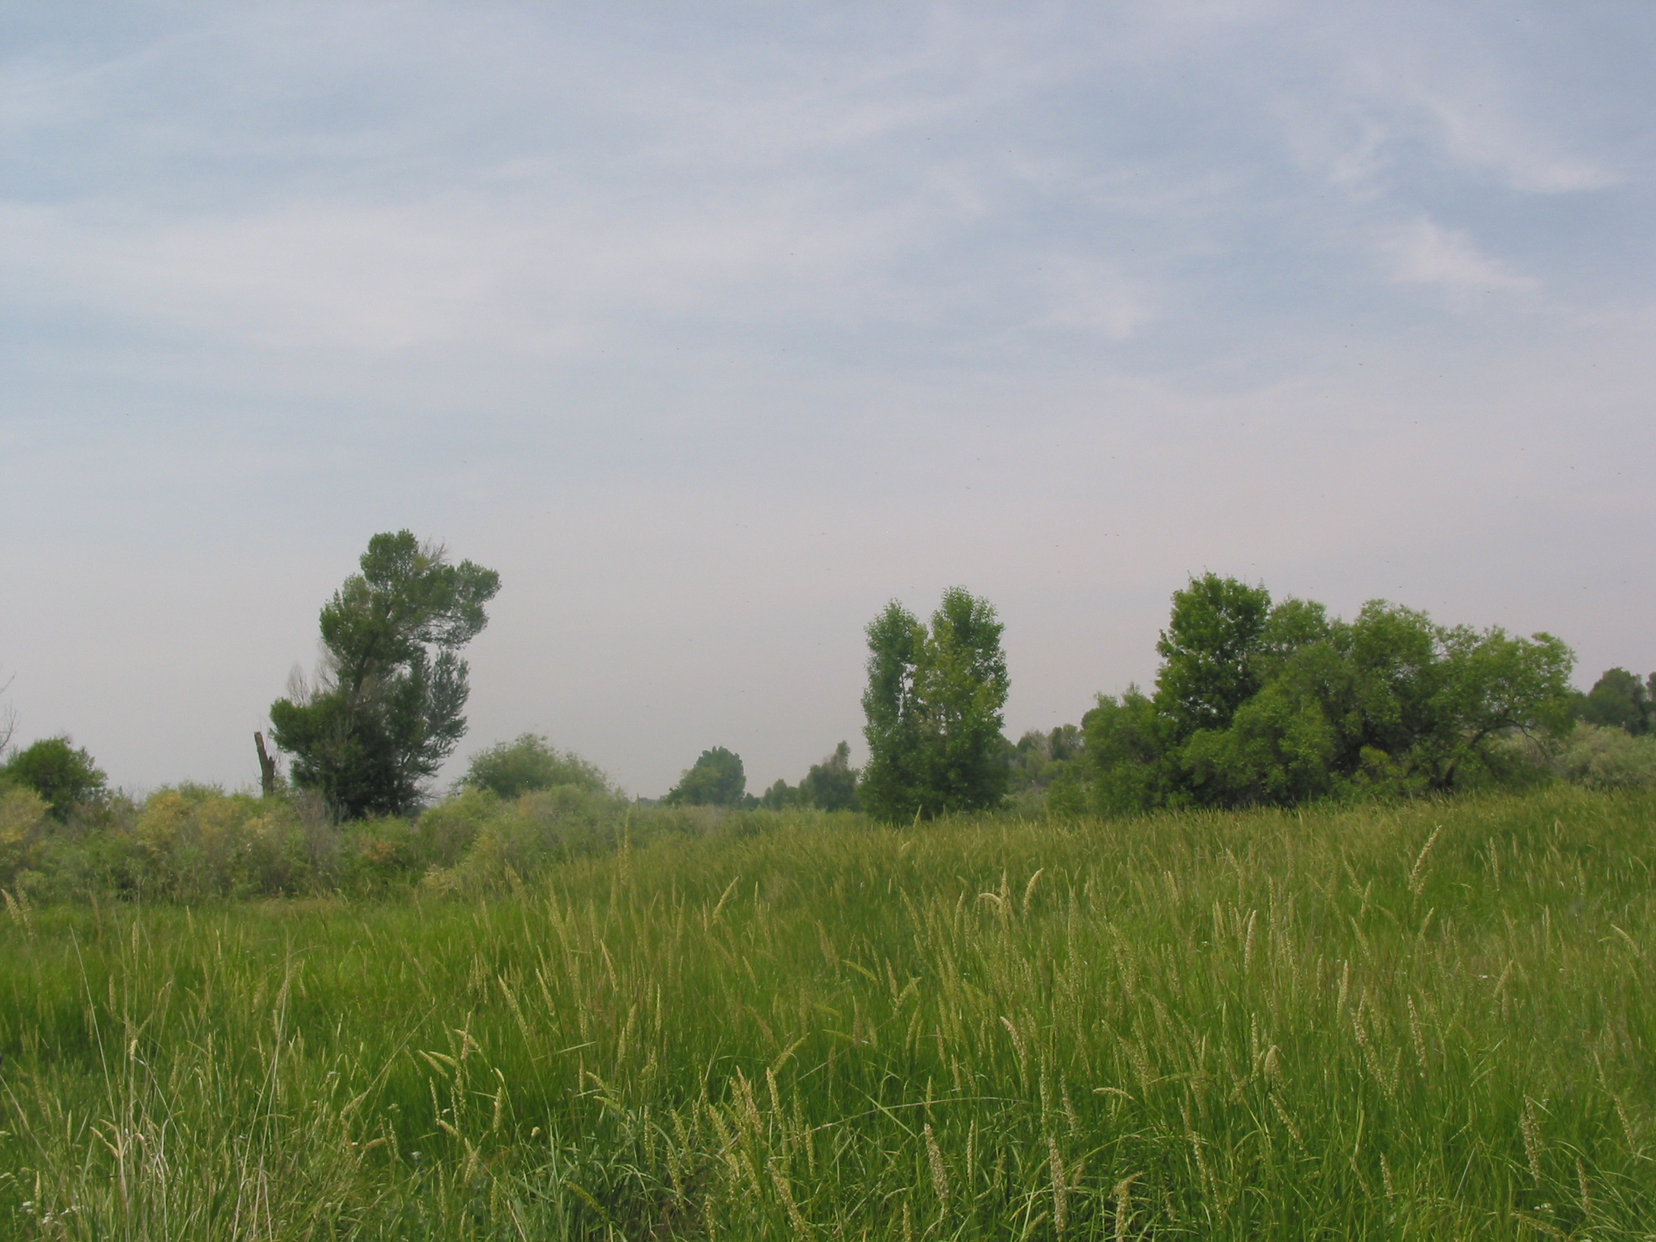
Fort Hall site

Slide 55
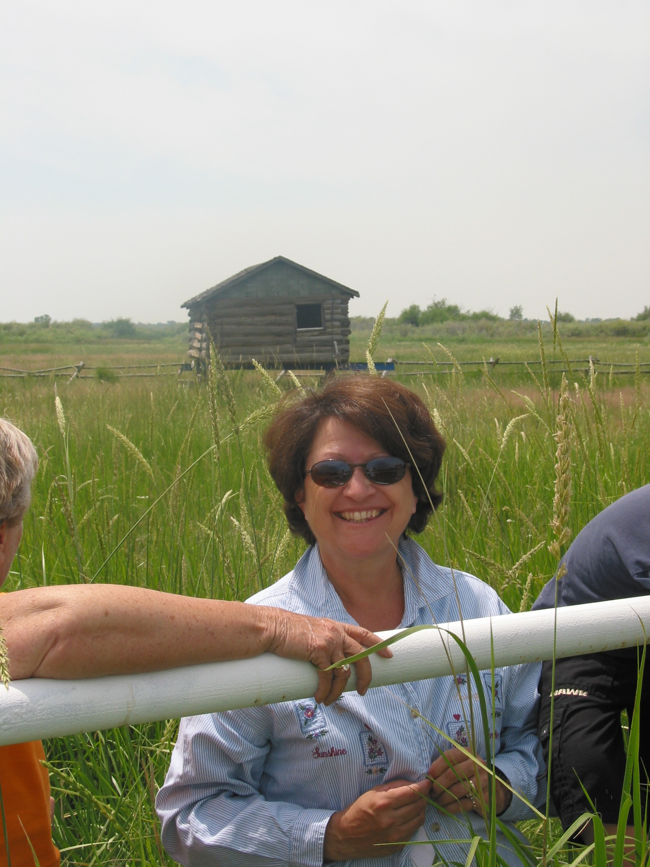
Old Fort Hall Site

Slide 56
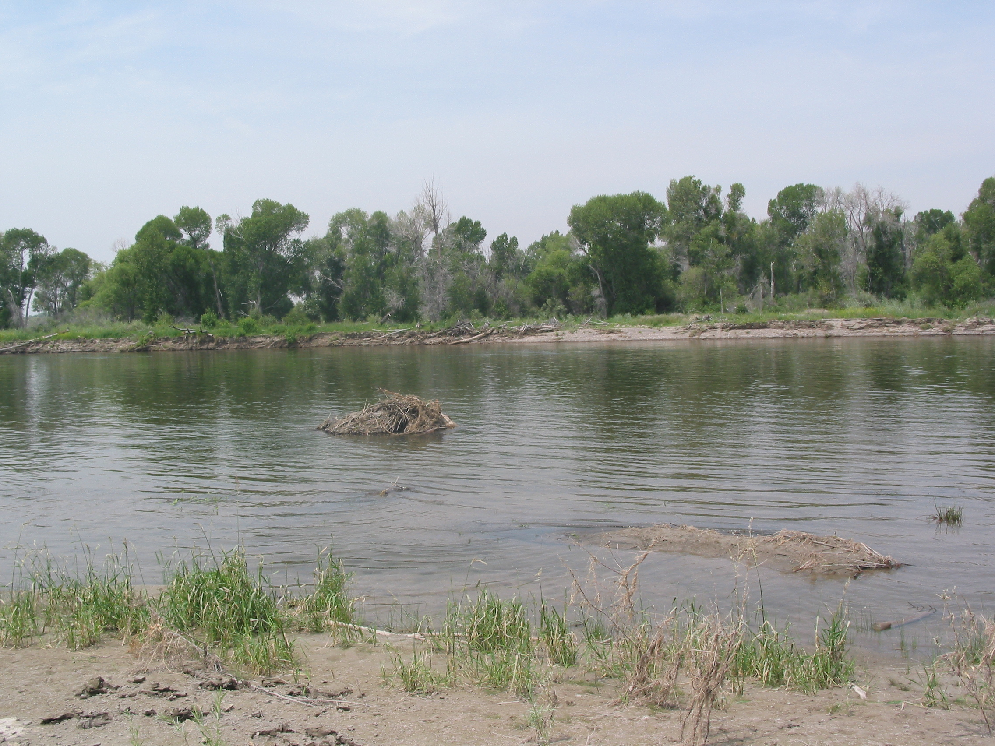
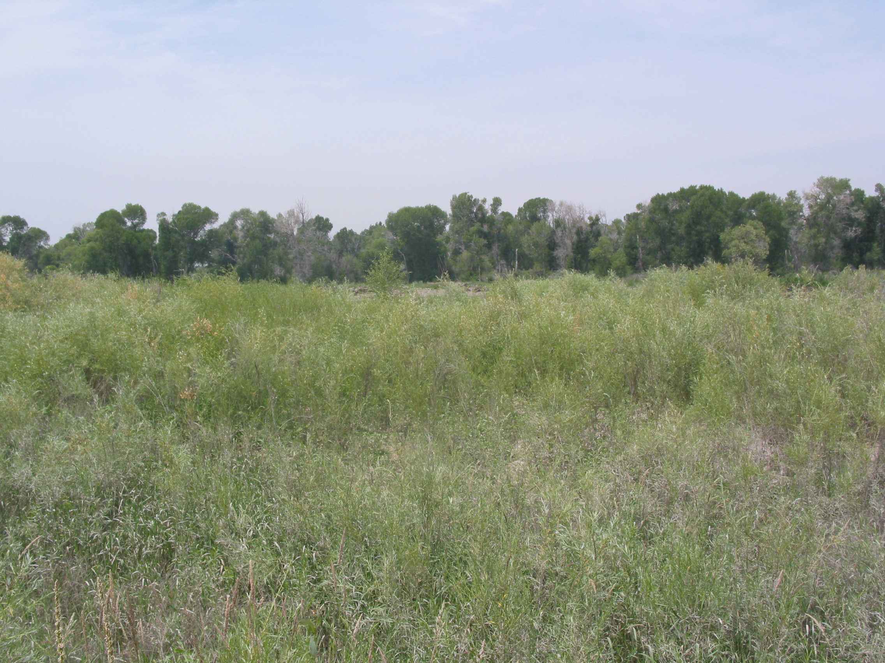
I am standing on what appears to be the old ferry abutment.
Lava rock and other types of rocks were placed in the bank
At this point looking West across the river

Slide 57
Snake River at what I judge to be the crossing

Slide 58
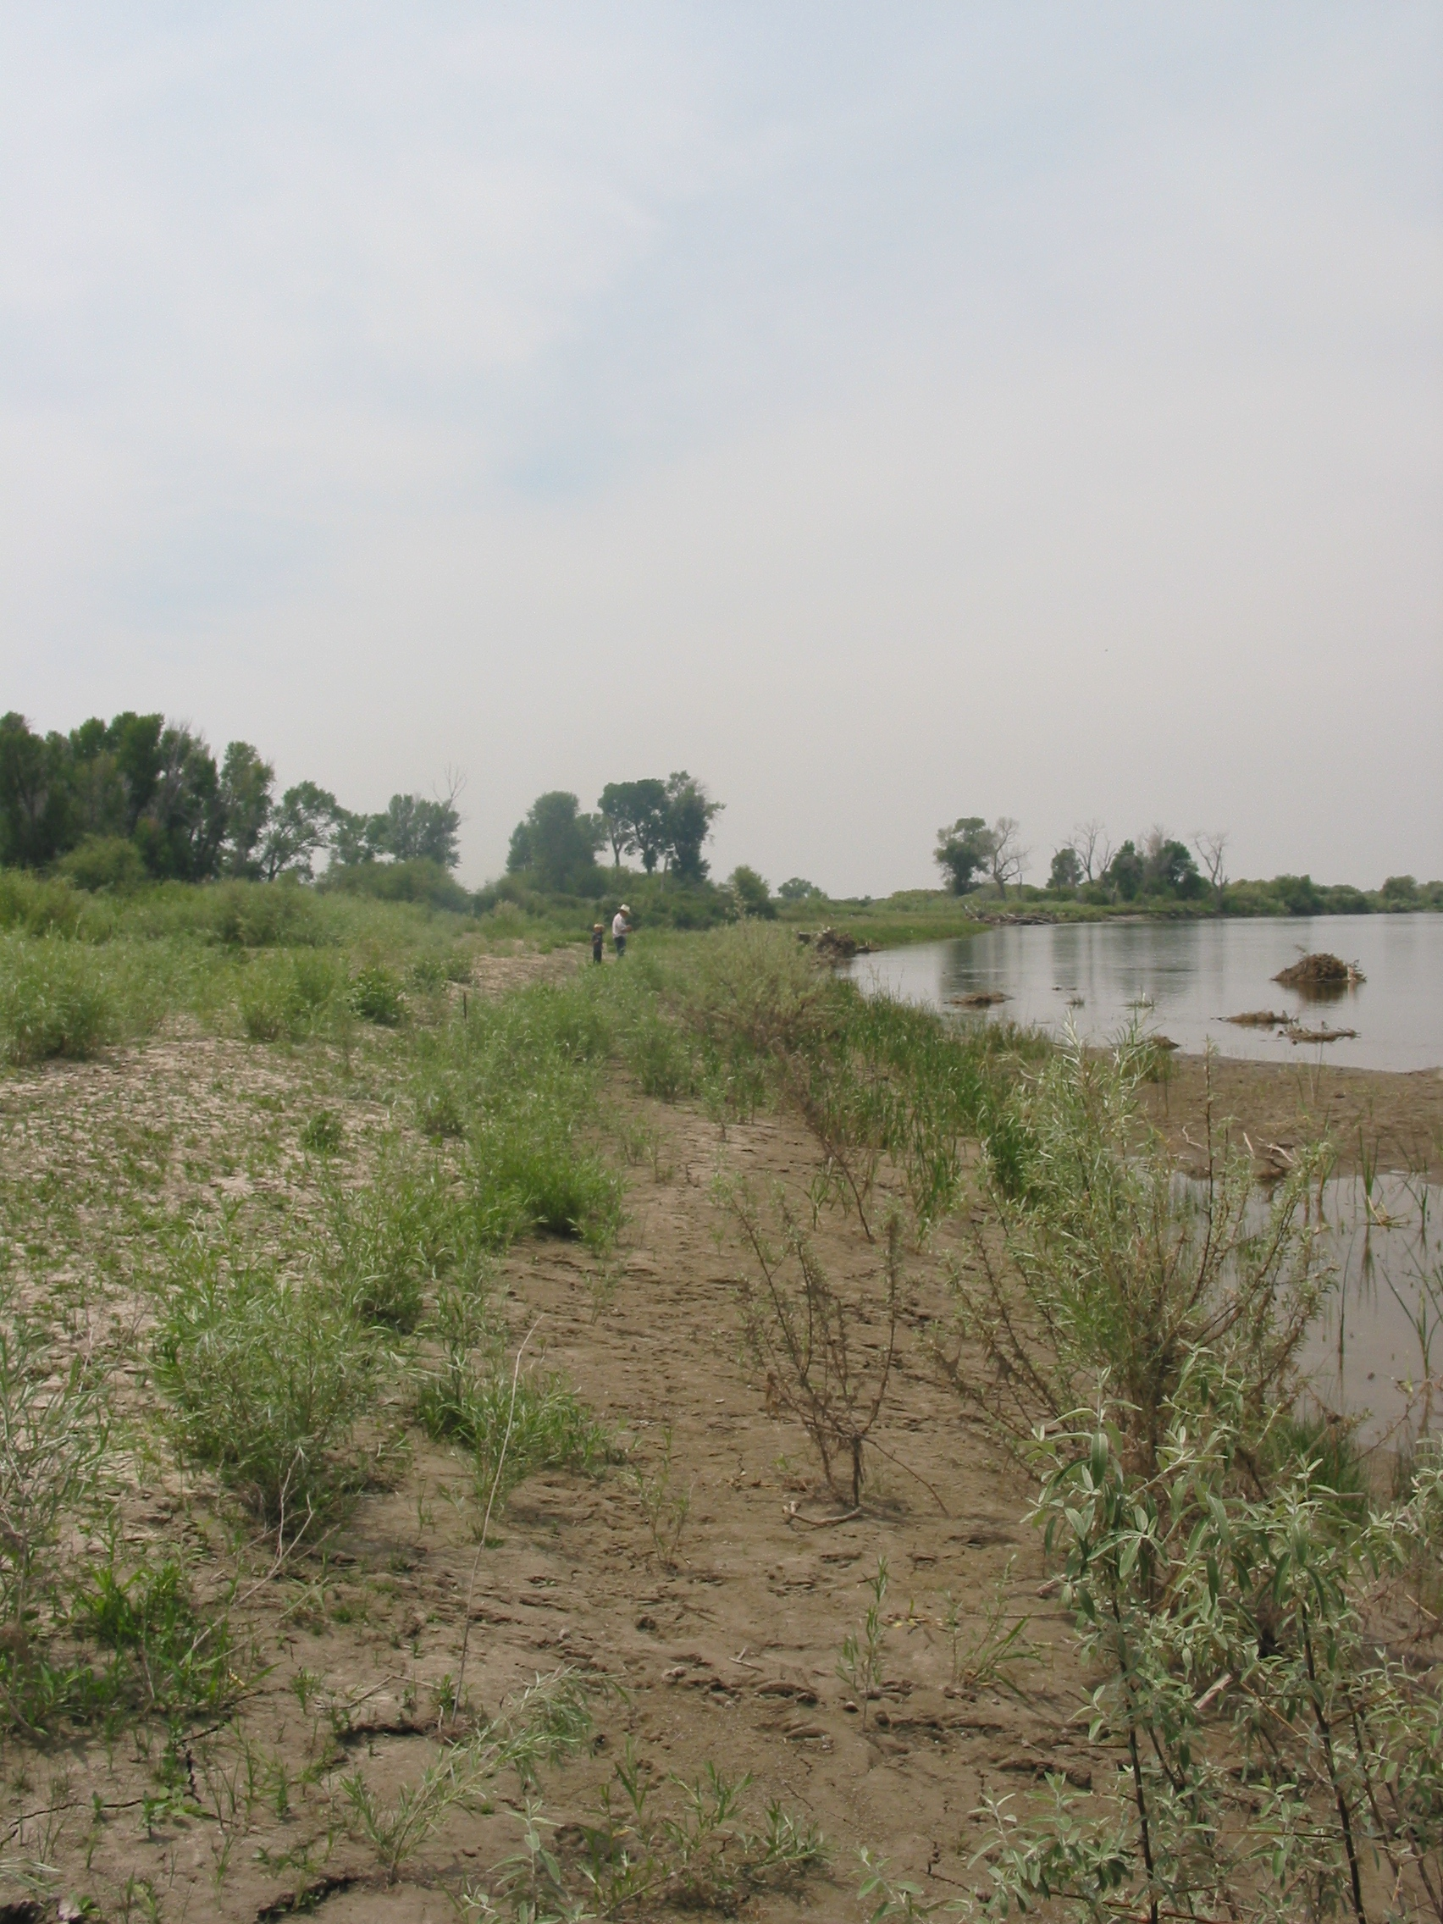
Looking West along the Snake River

Slide 59
Wednesday, May 30th, Remained in camp today. Three of the sons of
Laman were baptized in the church by G. W. Hill administrator
Thursday, May 31st. Repaired the boat and prepared for crossing
Snake River crossing 174 miles from Ogden
43 degrees, 02 minutes, 05 seconds North
112 degrees, 38 minutes, 28 seconds West
Greenwich, England. Elevation: 4371 feet

Slide 60
Friday June 1st. Crossed Snake River with out loss of animal, at place
Of our crossing said river is about three hundred yards wide.
Camped about I mile above ferry
43 degrees, 02 minutes, 05 seconds North
112 degrees, 38 minutes, 28 seconds West
Greenwich England. Elevation 4371

Slide 61
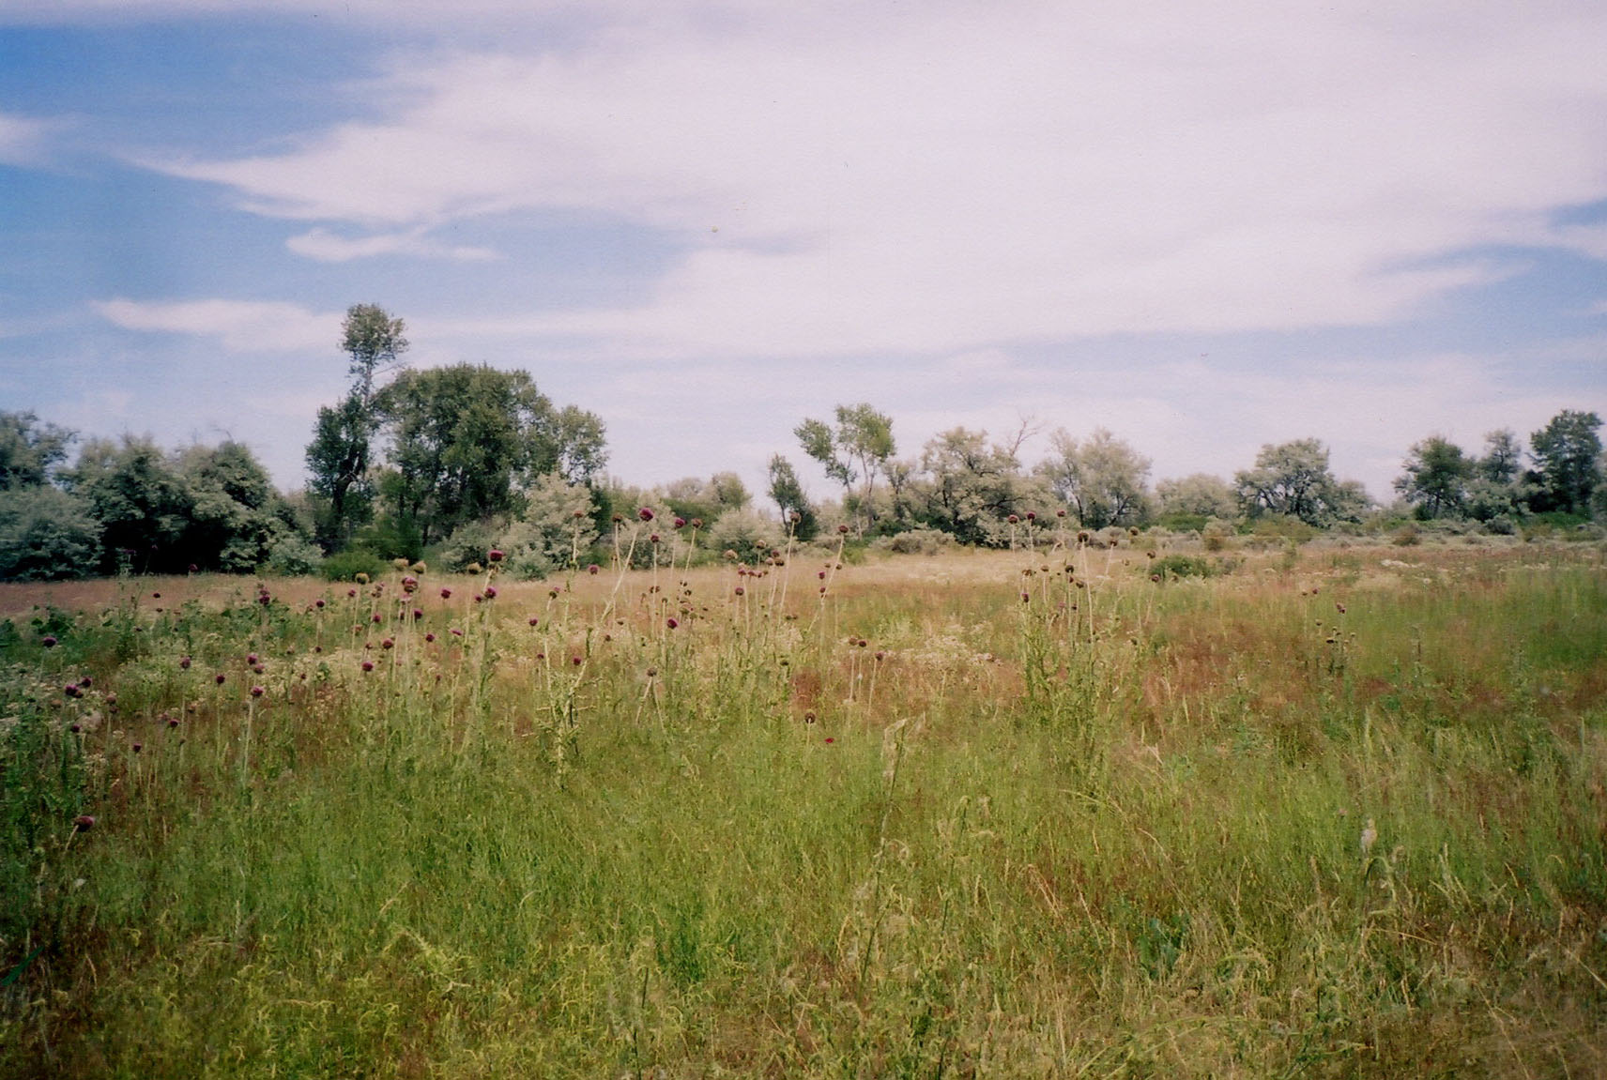
Clearing that is one mile above river crossing, in natural state

Slide 62
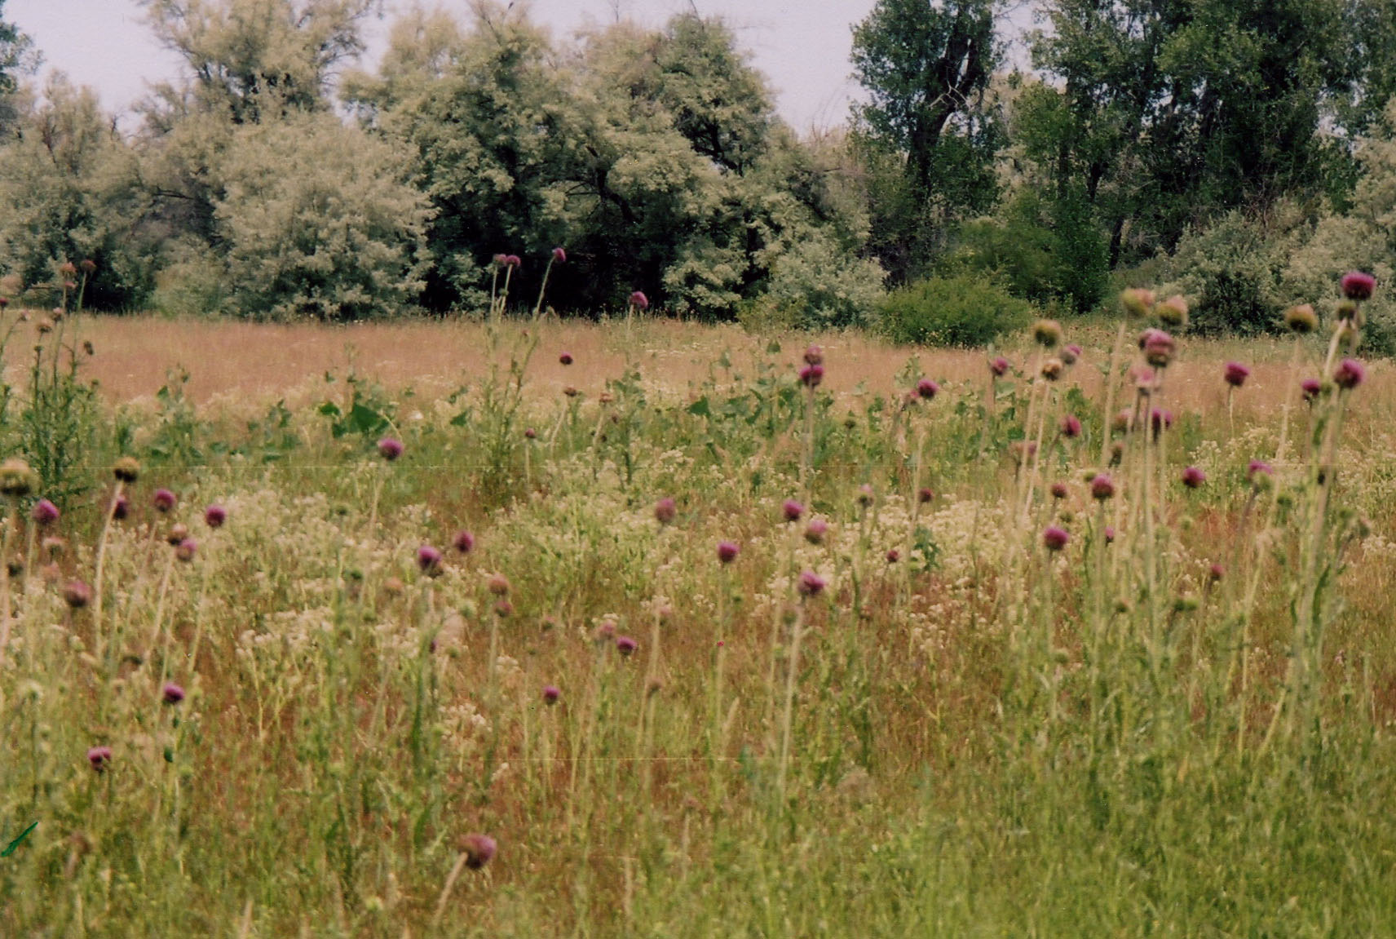
Close up of Russian Olive trees at edge of clearing

Slide 63
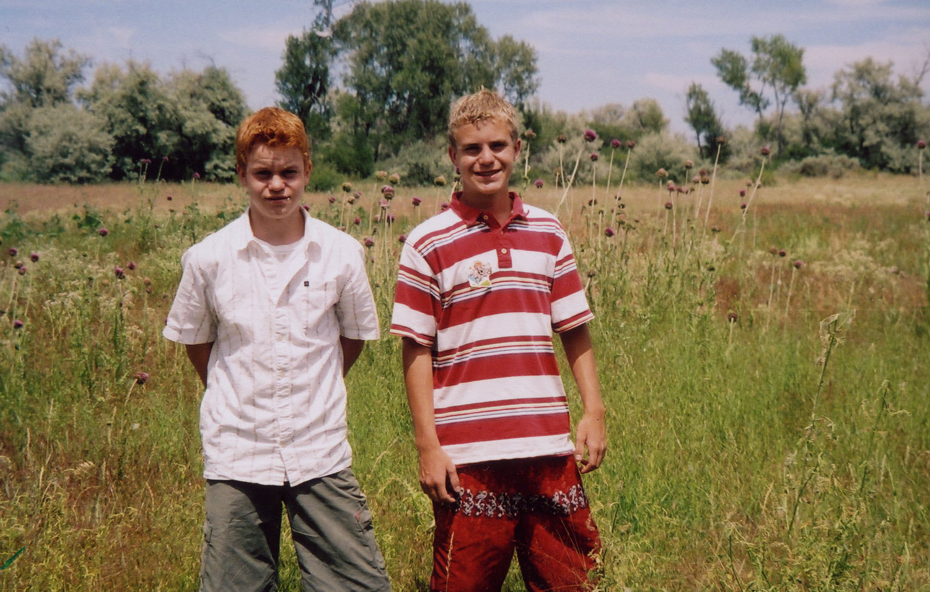
My grandsons James and Justin Marriott standing in camp site

Slide 64
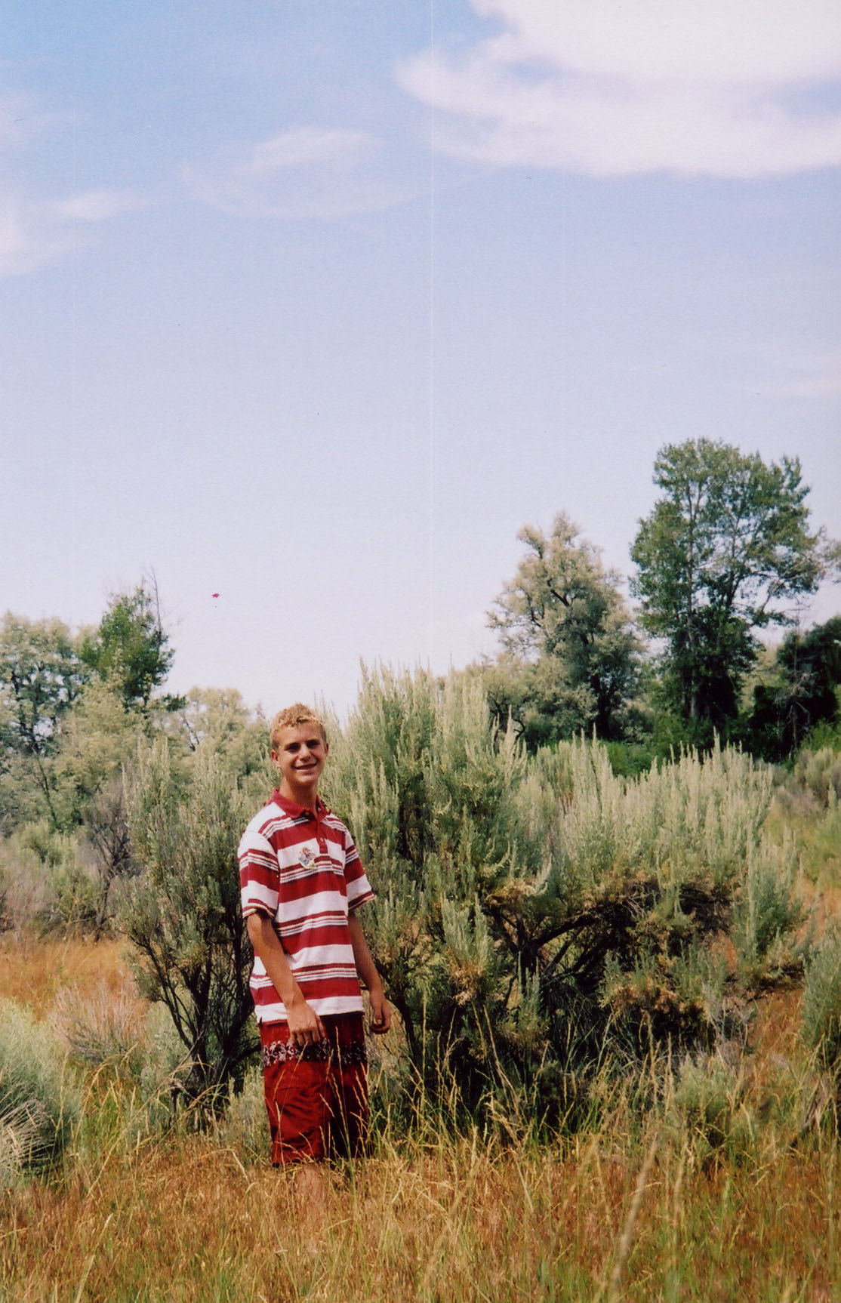
My grandson
Justin Marriott
5’ 8 “ tall. Sage brush
above his head

Slide 65
Saturday June 2nd. Traveled 15 miles in a dense forest of sage some six miles
Out of our direct course. Camped at an old fort on the Snake River.
There still remains at this place a dim trace of the Oregon emigrants.
The river at this point runs nearly due west.

Slide 66
Sunday June 3 1855, travelled 12 miles with the south wind blowing clouds
Of sand into the air, making it very disagreeable traveling. Camped on the
Snake river.

Slide 67
Monday June 4 1855, we traveled 18 miles and camped one and half miles
Below steam Boat Rock. At this place we were joined by one family of
IIndians by the name of Matigon.

Slide 68
Tuesday June 5 1855, in the morning J. W. Browning lost his horse. That day
We traveled ten miles and camped on the Snake River.

Slide 69
Wednesday June 6th. Traveled 20 miles. Rode through sage and rocks.
Struck camp after dark a Medicine Lodge on ( Carimash) Creek, which is a
Large creek that head into the Blackfoot Indian country.

Slide 70
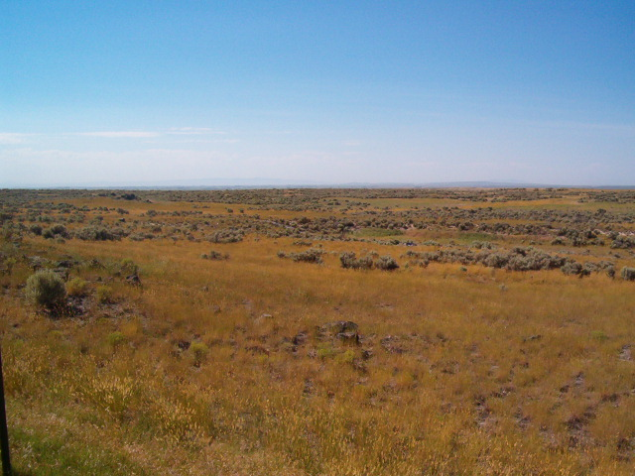
Looking South West on the route from Carmish Creek to Muddy Lake

Slide 71
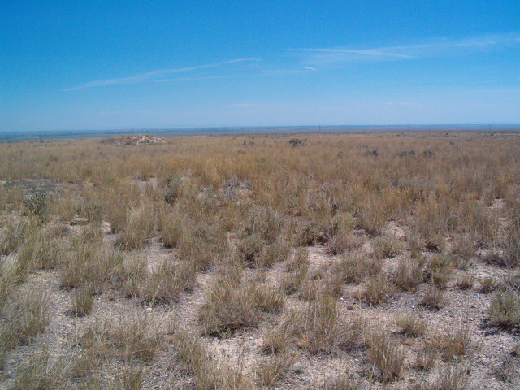
Looking South on the route from Carmish Creek to Muddy Lake

Slide 72
Thursday June 7th . Travelled 10 miles through sage and sand.
The Indians that came with us on the 4th left too-day and went
On to Salmon River to acquaint the Chief of our coming.
Camped at Muddy Lake
43 degrees, 53 minutes, 56 seconds North
112 degrees, 21 minutes, 55 seconds West
Greenwich, England. Elevation: 4958 feet

Slide 73
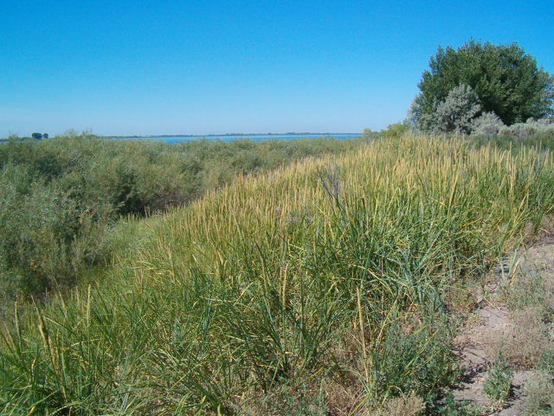
North side Muddy lake looking West

Slide 74
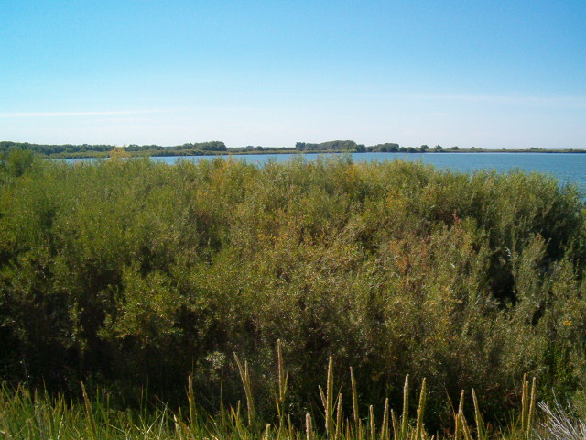
Muddy Lake looking South, found clam shells

Slide 75

Muddy Lake North boat ramp, looking South

Slide 76

Muddy Lake North boat ramp looking North

Slide 77
Friday, June 8th. Travelled 20 miles. Rode through sage and sand.
Camped at spring

Slide 78

Area where spring would have been next to the hill on the right side

Slide 79

Spring area

Slide 80
Saturday June 9th. Travelled 12 miles, course northwest. G W Hill shot
One antelope within one hundred yards of the train.
Camped at Spring Creek ( now called Birch Creek)
44 degrees, 08 minutes, 21 seconds North
112 degrees, 54 minutes, 01 seconds West
Greenwich , England. Elevation: 6041 feet

Slide 81

Birch Creek ( spring creek) crossing

Slide 82

Birch Creek (spring creek) camp looking North

Slide 83

Birch Creek (Spring Creek) Camp looking South

Slide 84

Birch Creek (Spring Creek ) Camp looking East

Slide 85

Birch Creek (Spring Creek) Camp looking North

Slide 86
Sunday, June 10th. Travelled 15 miles. Camped between two large Springs
In Water Valley
44 degrees, 15 minutes, 20 seconds North
112 degrees, 59 minutes, 12 seconds West
Greenwich, England. Elevation: 6519 feet

Slide 87

Road between two springs looking North

Slide 88

Road between two springs looking East

Slide 89

Road between two springs looking South East

Slide 90
Monday June 11th , traveled 25 miles, crossed over the mountains and
camped on a small branch of the Salmon River. Previous to going into camp
amidst heavy rain and hail, G W Hill killed a large black tail deer. Myself
and B. F. Cummings went after it with horses and got into camp at
11 o’clock at night.
These pictures were taken on the 11th of Nov and the weather would be
like he experienced on his return trip to Fort Limhi Nov 17 1855, were he
states “arrived—after a cold and disagreeable trip of thirty days”.
This spot is the first evidence of a stream, which comes out of a marsh
area going down hill from the pass.
44 degrees, 32 minutes, 18 seconds North Latitude
113 degrees, 18 minutes, 5 seconds West Longitude
Greenwich England. Elevation 6542 feet

Slide 91


Slide 92


Slide 93
Tuesday, June 12th. Traveled 15 miles today we were met by the Bannock Chief
Rock O K. Camped on another small branch of Salmon River.
44 degrees, 42 minutes, 48 seconds North Latitude
113 degrees, 24 minutes, 58 seconds West Longitude
Greenwich England Elevation 5825 feet

Slide 94


Slide 95


Slide 96
June 13, 1855 we traveled thirteen miles and camped on Big Cotton Wood
Creek ( now called Hayden Creek) , another branch of the Salmon River
With the intentions of exploring the country.
44 degrees, 52 minutes, 5 seconds north latitude
113 degrees, 37 minutes, 32 seconds west longitude
Greenwich England. Elevation 5179 feet
The tree line at the top of the picture is the creek coming in from the west

Slide 97


Slide 98

The Salmon river runs just beyond the
the red willows.

Slide 99
Wednesday, June 13th. Traveled 4 miles. Camped on Big Cottonwood,
Another branch of the Salmon River, with intentions of exploring the
country.
Thursday June 14th . Remained in camp and five of our company went on
an exploration expedition with the old chief.
Friday, June 15th Camp remained stationary. Went to the mountains about 8
miles west. Saw much beautiful timber.
Saturday, June 16th . The exploring party returned today.

Slide 100
Monday June 18th. Traveled 12 miles, arrived at our destination
Fort Lemhi 365 miles from Ogden. 33 days travel time
From the time of our landing up to the 13th of August, we had broken up some
15 acres of land and planted corn, potatoes, beans, peas, and a variety of
Other seeds and fenced the rise of fifty acres of land, built a large corral
Erected a stockade Fort 16 rods square and completed the building of five
Houses, besides a variety of other things too numerous to mention.
Sunday, July 29th. Salmon River missionary station was named Fort Limhi
By the unanimous vote of all present.
44 degrees, 59 minutes, 1 second north latitude
113 degrees, 38 minutes, 26 seconds west longitude
Greenwich England. Elevation 4807 feet

Slide 101

Idaho Highway Historical Marker Guide

Slide 102
Taken from the Historical Guide

Slide 103

Looking down from same spot as historical guide

Slide 104


Slide 105

Monument at Fort Limhi

Slide 106

Shed that protects remains of mud wall

Slide 107

Plaque on monument naming the pioneer party of 1855

Slide 108
Things I Learned about Gilbert Belnap
Excellent command of the English language
Never complained of hardship, except being away from family
Resourceful
Willing to work and get the job done
Inpatient with those who didn’t carry their share of the load
Willing to stay the course
Great faith

Slide 109
Trips to Fort Lemhi
Ogden to Fort Lemhi May 15th 1855 to June 18th 1855
Fort Lemhi to Ogden Aug 13th 1855 to Aug 26th 1855
Ogden to Fort Lemhi Oct 18th 1855 to Nov 17th 1855
Fort Lemhi to Ogden Jun 30th 1856 to Jul 15th 1856
Ogden to Fort Lemhi Oct 13th 1856 to Nov 4th 1856
Sep 29th 1857 He was sent by Brigham Young to
go to the relief of the white settlers in the Lemhi district in
Oregon
Distance traveled by oxen 2190 miles to and from Fort Lemhi
Omaha Nebraska to Salt Lake Valley 937 miles

Slide 110
Time Line Gilbert Belnap
Dec 22 1821 Born in Hope New Castle District Upper Canada
1831 At age of ten became an orphan
June 19 1839 Was released as a prisoner of war
April 12 1841 raised from bed of affliction
Sept 11 1842 Was baptized
Sept 1843 Served a mission to the State of New York
June 1 1844 Arrived in Nauvoo Met the Prophet Joseph Smith
Dec 21 1845 Married Adaline Knight
Winter of 1846 Lived in Winter Quarters
8 Jan 1847 First son born, Gilbert Rosel
11 May 1849 John McBride Belnap was born

Slide 111
15 June 1850 Left the banks of the Missouri for Salt Lake Valley
John McBride Belnap died on the trail
17 Sept 1850 entered the Great Salt Lake Valley
26 June 1852 Adaline and Henrietta McBride sealed in the endowment house
Spring of 1853 Moved to Ogden built small adobe house
5 Feb 1853 Appointed Ogden City Attorney
Oct 1853 Appointed company Commander of a Calvary Unit
26 April 1855 Set apart as missionary by Lorenzo Snow
16 May 1855 Departs on mission

Slide 112
One hundred and fifty one years ago tomorrow Aug 13th 1855
Gilbert along with F. Durfey, C.A. McGary, W.L. Brandage, G.R. Grant
I.J. Clarked, and E.J. Barnard dead head back to Ogden for supplies
One hundred and fifty one years from now, Aug 13th 2156, will your
descendants know what you were doing today?

Slide 113
Colonists added to the Pioneer Group
Moreland, Frank
Murdock, John
Nebeker, Henry
Perkins, William
Perry, William & wife
Preece, John
Quigley, Andrew
Robinson, Ebenezer
Robinson, Oliver
Rose, Orson H.
Shaw, William M.
Shurtliff, Haskell V.
Shurtliff, Lewis W.
Smith, Henry & wife
Smith, Jesse & wife
Smith, William & wife
Taylor, Levi & wife
Taylor, William & wife
Walker, James
Webb, Pardon
Welch, Fountain
Wilcox, James
Workman, Thomas
Wright, Amos, interpretor
Abbott, Thomas
Dalton, John L.
Day, Thomas
Dix, Owen
Green, Stephen
Hadlock, Hathren C.
Hadlock, James
Hammond, Milton D.
Harmon, Henry & wife
Harper, Joseph
Harris, Martin H.
Hill, Alexander
Lake, William Bailey
Leavitt, John
Margetts, Richard B.
Marler, William & wife
McBride, George
McBride, James
McIntyre, Wallace
Middleton, Charles F.
Miller, Fred A.
Miller, Jacob
Miller, James T.
Allred, James
Bain, Joseph
Barber, Washington
Baird, William
Barnard, Laclonius
Bingham, Thomas
Blanchard, John
Bloxum, John
Bloxum, Thomas
Brown, Joseph
Brown, Jonathan
Browning, Clifton S.
Clark, Jesse T.
Cleen, Stephen and wife
Cleveland, Henry A.
Cleveland, Henry R.
Collett, Ruben
Collett, Sylvanus
Corless, Thomas
Culer, Ben

Slide 114
The End
Produced by Jim Marriott, a great great grandson of Gilbert Belnap
Narration by Jim Marriott

